Slide 1


NC Association of Medical Staff Services Meeting
Editable Image
Utilization Management role in the hospital.
11/19/2021

Slide 2
What Does UMPA and Physician Advisory Services mean?
UMPA stands for Utilization Management Physician Advisor
A Physician with good standing amongst peers and preferably with credentials and privileges at the hospital.
CMS requires UMPA for COP (conditions of participation) for various regulatory work.
They are a part of the Utilization Management Committee, a regulatory body required for the hospital and focuses on quality, utilization of resources (like radiology svcs, telemetry, appropriate admissions) and provider behavior issues.

Slide 3
Medical Director, Clinical Resource Services
What are the day-to-day functions of UMPA?
Case Management/Social Work
Right status/Level of care consults: med and surgery
Denials Management
LOS
Clinical Documentation Improvement
Physician Liaison
Throughput issues
Quality and Performance Improvement Projects
Point of contact for compliance and regulatory issues
Sources: source text goes here

Slide 4
Medical Director, Clinical Resource Services
Status Options: Inpatient or Outpatient
Inpatient: 2 MNs anticipated based on severity of sickness and intensity of service (the key to avoiding any denials, backend status change and decreasing administrative burden)
Outpatient with Observation Services: Medically necessary hospital care that is NOT anticipated to span two midnights
Outpatient Extended Recovery: Routine recovery after an elective procedure that is NOT anticipated to span two midnights
Outpatient Needs a Bed: Medically unnecessary care (custodial care) provided for patients who are admitted for purposes of arranging a safe discharge plan

Slide 5
Denials Management
Increasing volume, especially MA and commercial payers
Concurrent and retro
Process to avoid and decrease numbers
P2P while inhouse and post Discharge
Change in status while in house and post discharge
Surgical cases: auth and post surgical orders

Slide 6
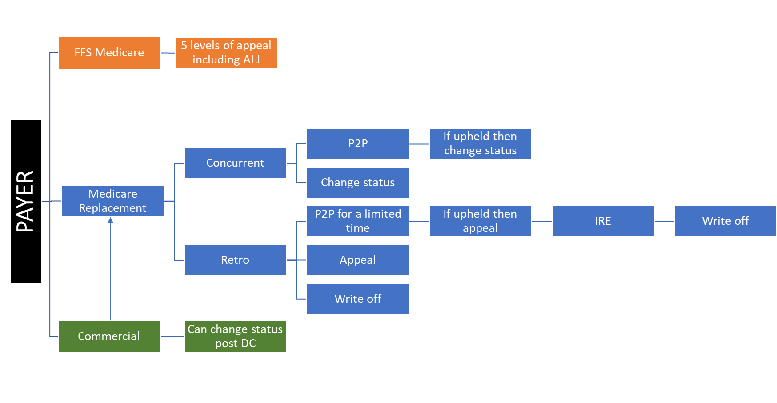
Denials Management

Slide 7
Examples of denials and Financial impact
Inpatient paid as $7000
Obs at $2200
OPNB $0
Requires order to bill at the above level, prior to discharge.
Example: Pt was inpt, payer denied. Appeal was done and upheld. For commercial payer, we can change after DC. Obs order was received from the Attending and we received $10K.
If order for IP, but the case is appropriate for obs and we do not change prior to DC, then we get paid nothing.

Slide 8
Gross Revenue by Discharge Date:
Sum of Total Charges | Column Labels
 | 2020 |  |  | 2021 |  |  |  |  |  |  |  |  | Grand Total
Row Labels | Oct | Nov | Dec | Jan | Feb | Mar | Apr | May | Jun | Jul | Aug | Sep
Billed | $935,680 | $167,972 | $123,184 | $560,658 | $353,784 | $352,182 | $557,349 | $589,809 | $913,800 | $828,556 | $944,788 | $185,737 | $6,513,499
Closed | $859,120 | $750,409 | $491,683 | $1,042,435 | $790,807 | $272,771 | $1,025,446 | $387,571 | $955,075 | $200,537 | $577,228 | $46,237 | $7,399,318
Grand Total | $1,794,801 | $918,380 | $614,867 | $1,603,093 | $1,144,591 | $624,953 | $1,582,795 | $977,380 | $1,868,875 | $1,029,092 | $1,522,015 | $231,974 | $13,912,817
Net Revenue by Discharge Date:
Sum of Net Revenue | Column Labels
 | 2020 |  |  | 2021 |  |  |  |  |  |  |  |  | Grand Total
Row Labels | Oct | Nov | Dec | Jan | Feb | Mar | Apr | May | Jun | Jul | Aug | Sep
Billed | $214,619 | $24,610 | $36,159 | $202,301 | $141,908 | $100,135 | $184,093 | $268,991 | $267,710 | $267,609 | $347,106 | $54,715 | $2,109,958
Closed | $246,564 | $249,386 | $225,278 | $266,078 | $230,287 | $113,930 | $399,609 | $111,457 | $170,427 | $73,967 | $273,003 | $42,631 | $2,402,616
Grand Total | $461,183 | $273,996 | $261,437 | $468,379 | $372,195 | $214,065 | $583,703 | $380,448 | $438,137 | $341,576 | $620,110 | $97,346 | $4,512,574

Slide 9



Medical Director, Clinical Resource Services
Transfer Center Referrals
EMTALA Violations
Potential $50,000 fine
Termination from Medicare and Medicaid
Potential lawsuit for civil damages
Potential lawsuit for civil rights violations
Publication of the violation and penalty

Slide 10
Why is the Advisory program and what we do important?
Comply with CMS regulations.
Right status could mean lots of benefits vs not for the pt.
Right status could mean financial hit to the pt.
Decrease Denials which is worth of millions of $$ and counting
Capture SOI and ROM
Quality metrics which are used as benchmarks for nationwide comparison.
Helps with payer contract negotiations.
Liaison for the provider community and the Administration.

