Slide 1


Cybersecurity:
Current Climate in Healthcare
  Prepared by Eddie Parrish
  11/19/21 V1.0

Slide 2
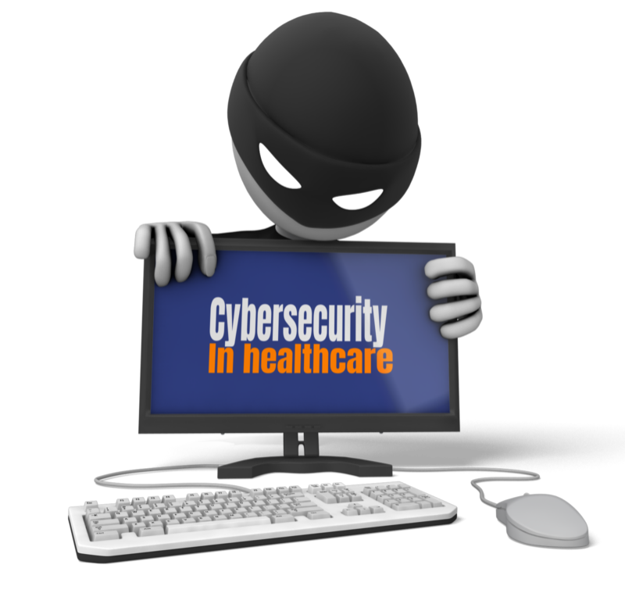
Learning Objectives
Articulate the importance of security awareness
Understand top security threats facing healthcare
Understand steps to help protect yourself and organization

Slide 3
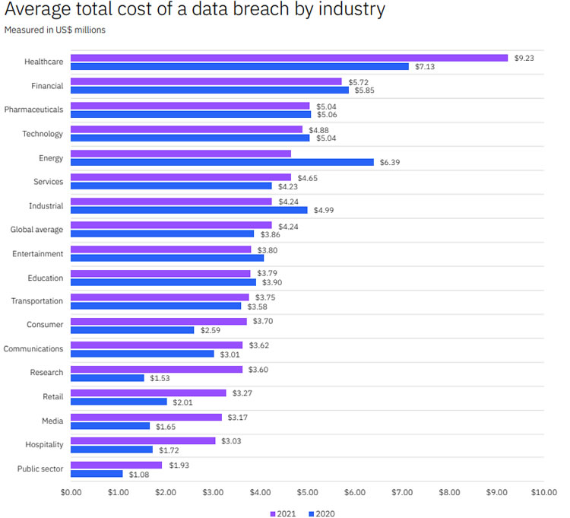
Did you know!
The Average Cost of a Healthcare Data Breach is Now $9.42 million
Source: HIPAA Journal July 2021
Notes:
To compile the report, IBM conducted an in-depth analysis of data breaches involving fewer than 100,000 records at 500 organizations between May 2020 and March 2021, with the survey conducted by the Ponemon Institute.
The most common root cause of data breaches in the past year were compromised credentials, which accounted for 20% of data breaches. These breaches took longer to detect and contain, with an average of 250 days compared to an overall average of 212 days
Breaches involving customers’ personally identifiable information (PII) were more expensive than breaches involving other types of data, with a cost per record of $180 when PII was involved compared to the average of $161 per record for all types of data.
Healthcare Industry has Highest Number of Reported Data Breaches in 2021

Slide 4

Did you know!
The Average Cost for per breached healthcare record is $429
One study values patient records at $1000 each
Source: HIPAA Journal July 2019
For The Record March 2016
Notes:
Healthcare Data Breaches Cost $429 per Record
In healthcare, the average cost of a breach has increased to $429 per record from $408 last year – an increase of 5.15%. The financial sector has the second highest breach costs. Financial industry breaches cost an average of $210 per record – less than half the per record cost of a healthcare data breach.

Slide 5

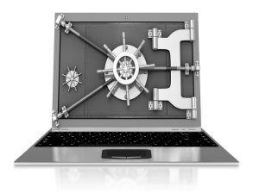
Why do I need to learn about Cybersecurity –
Isn’t this just an IT/IS Problem?
Anti-Virus Software
90% of security safeguards rely on the people to use good security practices.
People
Encryption
Firewalls
TECHNICAL
90%
10%
10% of security safeguards are technical
Notes:
Discuss the 10% - 90% Rule
All the technologies – Firewalls, routers, encryption, anti-virus software, patching software, DMZ
Can be surpassed by a person not following good security practices.

Slide 6
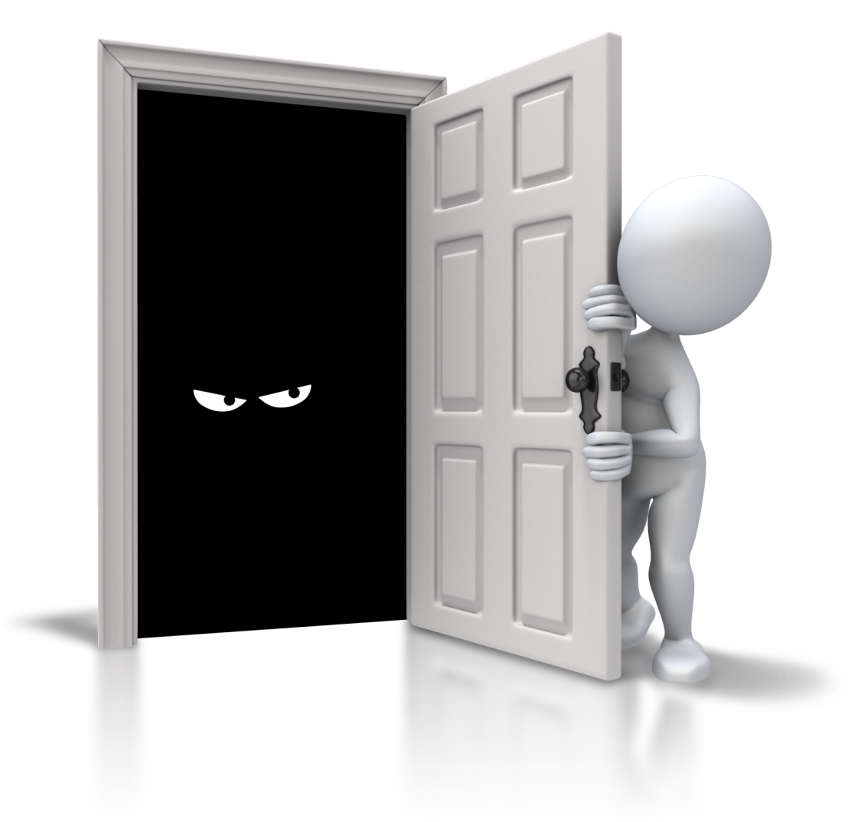
Example
The lock on a door is the 10% (Technical)
The other 90% includes:
(People)
Remembering to:
Close the door
Lock the door
Ensure others have not propped the door open
Set the alarm
Safeguarding the key
Notes:
Discuss how you can put security on a door but it can be easily by-passed by people not using or bypassing the security that is in place.

Slide 7
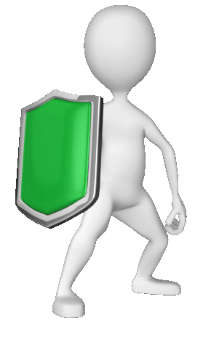
10% Security is Worthless without You!
Security
urit!
Notes:
Discuss how you can put security on a door but it can be easily by-passed by people not using or bypassing the security that is in place.

Slide 8
Top Cybersecurity Threats!
Phishing
Malware/Ransomware
Third party vulnerabilities
Notes:
There are several security threats but our focus will be on these three today which are of primary concern within Healthcare and other industries

Slide 9

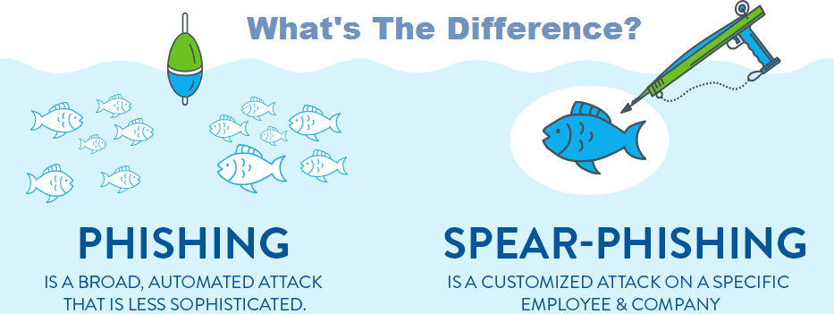
Phishing
Whaling: Form of spear phishing directed at executives or other high-profile targets.

Slide 10

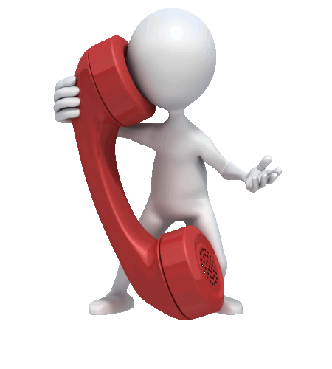
Phishing
SMS phishing or Smishing – Scammers using text messages
Voice phishing or Vishing – Scammers using telephone

Slide 11
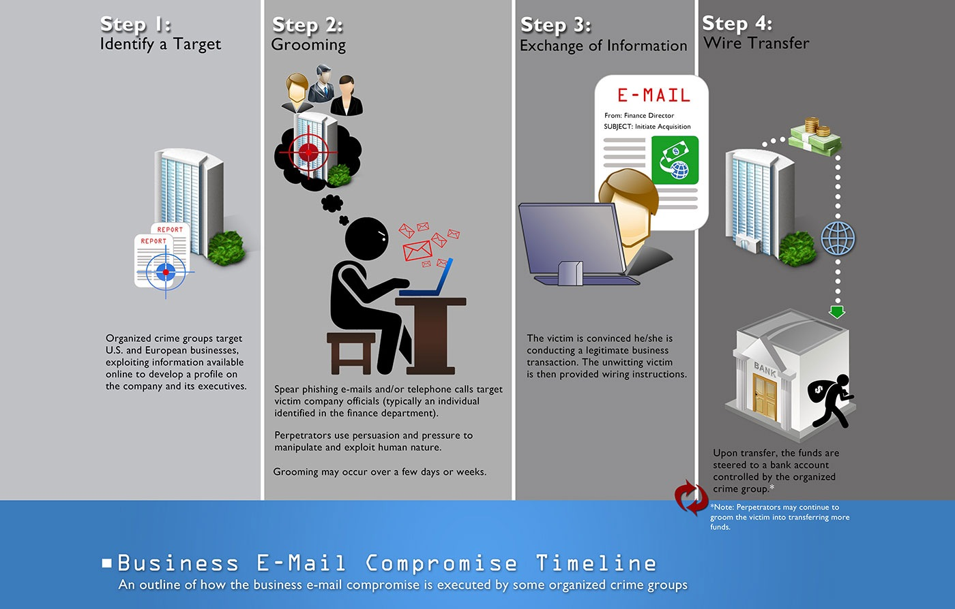
Phishing
Business
e-mail compromise (BEC)
Notes:
https://www.fbi.gov/scams-and-safety/common-scams-and-crimes/business-email-compromise#How-BEC%20Works.

Slide 12
Phishing - Protection
Be careful what information you share online or on social media
Check the links before you click
Refuse to provide usernames or passwords
Before careful what you download or open
Notes:
https://www.fbi.gov/scams-and-safety/common-scams-and-crimes/business-email-compromise#How-BEC%20Works.

Slide 13
Phishing - Protection
Verify payment and purchase requests
Be cautious when then requestor is pressing you to act quickly
Use two-factor or multi-factor authentication
Use strong passwords (pass phrase)
Report suspicious “phishing
Notes:
https://www.fbi.gov/scams-and-safety/common-scams-and-crimes/business-email-compromise#How-BEC%20Works.

Slide 14

Strong Password
Use a Passphrase
1. Add words to create a phrase
I love Kure beach
Add capital letters and numbers
IL0veKUREbeach
3. Add punctuation
IL0veKUREbeach!
Notes:
https://www.fbi.gov/scams-and-safety/common-scams-and-crimes/business-email-compromise#How-BEC%20Works.
https://howsecureismypassword.net/
IL0veKUREbeach -9 million years for computer
IL0veKUREbeach! - 15 billion by adding ! -
A password should be 16 characters or more; our password-related research has found that 45 percent of Americans use passwords of eight characters or less, which are not as secure as longer passwords.
A password should include a combination of letters, numbers, and characters.
A password shouldn’t be shared with any other account.
A password shouldn’t include any of the user’s personal information like their address or phone number. It’s also best not to include any information that can be accessed on social media like kids’ or pets’ names.
A password shouldn’t contain any consecutive letters or numbers.
A password shouldn’t be the word “password” or the same letter or number repeated.
https://www.security.org/how-secure-is-my-password/
https://securityboulevard.com/2021/03/nist-password-guidelines-2021-challenging-traditional-password-management/

Slide 15
Malware/Ransomware
Malware: malicious software that is specifically designed to disrupt, damage, or gain unauthorized access to a computer system.
Ransomware: malicious software that blocks access to your device until you pay a ransom.
Notes:
https://www.fbi.gov/scams-and-safety/common-scams-and-crimes/business-email-compromise#How-BEC%20Works.
Data breach by industry: healthcare has the highest cost.
53% of malicious breaches had financial reasons.
5% of malicious breaches involved BEC.
14% of malicious breaches involved phishing.
3% of malicious breaches involved social engineering.
USD 4.44 million was the average cost of a ransomware breach.
Incident response (IR) was the highest cost saver for business

Slide 16
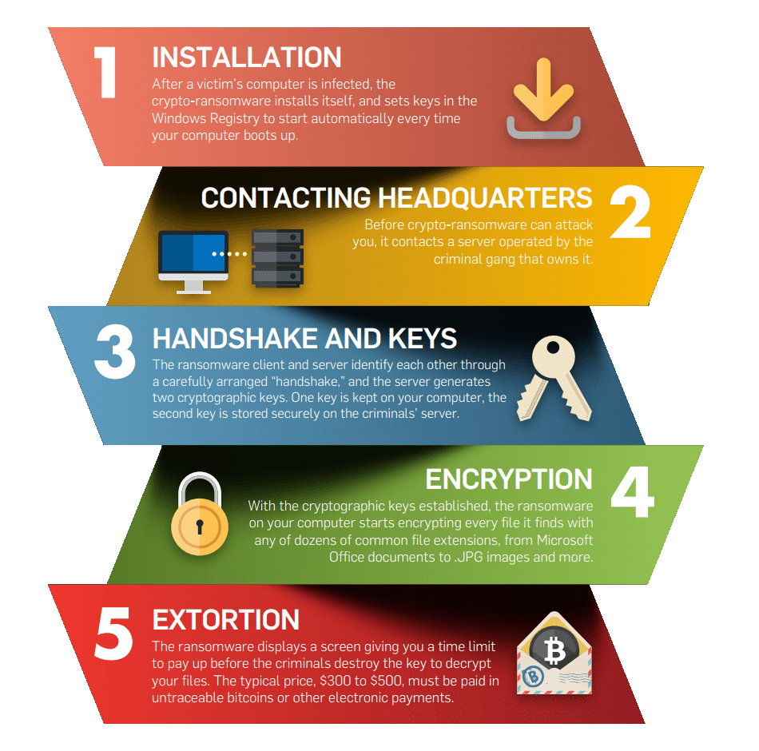
Ransomware
The Five stages of ransomware.
Notes:
A ransomware attack goes through five stages from the time it installs on your computer to the appearance of the ransom warning on your screen. You can download our step-by-step infographic to learn about the stages of an attack, and get tips on staying safe.
Suspected Ransomware Payments Nearly Doubled This Year, Treasury Says
“Financial firms flagged nearly 600 million in suspected ransomware payments; Treasury investigators identified billions more”
Source: The Wall Street Journal October 2021

Slide 17
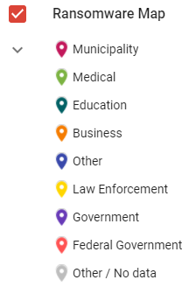
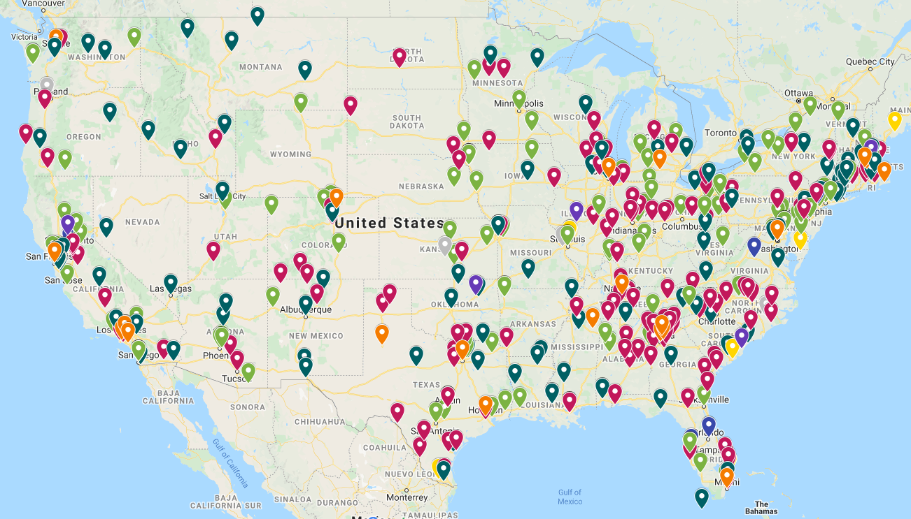
Ransomware
“The FBI received nearly 2,500 ransomware complaints in 2020, up about 20 percent from 2019”
Notes:
https://www.google.com/maps/d/u/0/viewer?mid=1UE6Nko9iRG1tLci_AeqqsxzxGzs&ll=39.01614085992453%2C-99.74006266586969&z=5
https://www.pcmatic.com/ransomware

Slide 18
Ransomware
In 2020, 560 healthcare organizations were victims of ransomware attacks
Ransomware attacks costs healthcare organizations $20.8 billion in downtime in 2020
Hospital ransomware attack led to infant's death, lawsuit alleges
Source: Beckers Hospital Review July 2021
Healthcare IT News October 2021
Notes:
A ransomware attack goes through five stages from the time it installs on your computer to the appearance of the ransom warning on your screen. You can download our step-by-step infographic to learn about the stages of an attack, and get tips on staying safe.
Suspected Ransomware Payments Nearly Doubled This Year, Treasury Says
“Financial firms flagged nearly 600 million in suspected ransomware payments; Treasury investigators identified billions more”
Source: The Wall Street Journal October 2021
https://www.healthcareitnews.com/news/hospital-ransomware-attack-led-infants-death-lawsuit-alleges

Slide 19
Ransomware
Utilize multi-factor authentication
Keep operating systems, software, and applications current and up to date.
Make sure security solutions are up to date.
Back up data regularly and double-check that those backups were completed.
Utilize multi-factor authentication
Source: fbi.gov
Notes:
A ransomware attack goes through five stages from the time it installs on your computer to the appearance of the ransom warning on your screen. You can download our step-by-step infographic to learn about the stages of an attack, and get tips on staying safe.
Suspected Ransomware Payments Nearly Doubled This Year, Treasury Says
“Financial firms flagged nearly 600 million in suspected ransomware payments; Treasury investigators identified billions more”
Source: The Wall Street Journal October 2021

Slide 20
Ransomware
Secure your backups. Make sure they are not connected to the computers and networks they are backing up.
Create a continuity plan in case your business or organization is the victim of a ransomware attack
Review and exercise your incident response plan
Source: fbi.gov
Notes:
A ransomware attack goes through five stages from the time it installs on your computer to the appearance of the ransom warning on your screen. You can download our step-by-step infographic to learn about the stages of an attack, and get tips on staying safe.
Suspected Ransomware Payments Nearly Doubled This Year, Treasury Says
“Financial firms flagged nearly 600 million in suspected ransomware payments; Treasury investigators identified billions more”
Source: The Wall Street Journal October 2021

Slide 21
Third Party Vulnerability
A company or entity with a direct written contract to provide products or services to your customers on your organization’s behalf.
Notes:
Third-party vendors typically have access to sensitive data like company, customer, and employee information. A 2019 eSentire survey found that nearly half of all organizations experienced a data breach caused by a third-party vendor. A vendor is any company or entity that provides goods and services to you or your company. This is a broader term that encompasses any and all vendors that your organization works with across departments. More specifically, a third-party vendor is anyone who is providing goods and services to your organization to maintain daily operations, and potentially also on behalf of your organization. Thus, third-party vendors are a narrower subset of vendors in general.

Slide 22
3rd Party Vulnerability - Example
Kaseya, remote monitoring and management software
Ransomware group exploited a vulnerability in the software
1,500 companies worldwide were affected.
Grocery retailer forced to close 800 stores
Called the largest ransomware in history
Vast majority of companies did not pay the ransom
Notes:
This included a Swedish grocery retailer co-op chain, which was forced to close more than 800 stores. Following the attack, REvil demanded a $70 million payment in bitcoin to decrypt all the systems.
https://www.panorays.com/blog/the-5-most-notable-third-party-data-breaches-of-2021-so-far/

Slide 23
Third Party Vulnerabilities
Third-party business associates are increasingly becoming targets.
Assess your Third-Party Risk Management
  Assessment – Gather and analyze data related to your third parties’ risk
  Resolution – Implement short and long-term measures to immediately eliminate exposure
Notes:
Why is Third Party Risk Management essential in healthcare
https://blog.rsisecurity.com/basics-of-third-party-risk-management-in-healthcare/
Clients
Vendors
Partners
Suppliers
Contractors

Slide 24

Questions?

