Slide 1
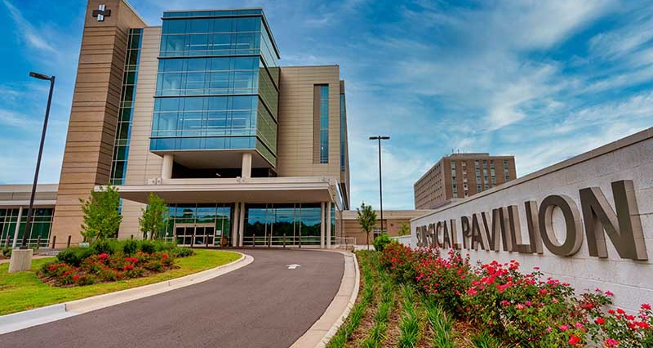

Large Presentation Title in Arial Regular.
Mesha Chadwick MD
NH NHRMC Med Staff President 2020-2021
WH Hospitalist
NH NHRMC UMPA
NCAMSS Quarterly Meeting November 19, 2021
Subtitle heading is in Arial Bold.
  Date and version no.

Slide 2
Onboarding
Key elements of provider orientation
Benefits of provider orientation including Medical Staff Leadership – employed and elected.
Identify key responsibilities of Med Staff Leadership at the new provider orientation

Slide 3
Elements of provider orientation
Connect
Get to know your providers, make eye contact, listen, ask questions.
Be deliberate in your actions.
Communicate
Provide clear, concise, consistent communication without fail.
Construct/Cultivate
Build a relationship on accountability and trust to ensure retention, workplace satisfaction and overall better care for patients.
Create an orientation checklist which advances throughout the orientation process not just on day one
Condition and Support
Prepare them for any obstacles commonly faced by other providers during the onboarding process.
“Your Vibe Attracts Your Tribe”

Slide 4
Benefits of provider orientation that includes Medical Staff Leadership - employed and elected
Provider orientation conducted with a heavy emphasis on personalized involvement from MSL demonstrates commitment to physician engagement, education and partnership.
By taken the extra steps to ensure high quality orientation will maximize a provider’s performance which ultimately results in long term meaningful retention.
MSL positions which allow both employed and private providers to be elected help to create a stronger unbiased integrated health system.

Slide 5
Responsibilities of Med Staff Leadership at new provider orientation
Orientation guide
Overview of past, present and future state
Mission and core values
Introduction to senior leadership team
Overview of med staff organization
Med staff categories
Active, Courtesy, Affiliate
Allied health professionals
Category I, II, III
Medical staff meetings
Communication
Physician to physician, email, platforms used at institution
Expectations
Code of Conduct
Provider Peer Review Process
On call responsibilities
Medical records completion and suspension, CDI
HIPPA privacy laws
Direct admissions and transfers what is expected

Slide 6
Acute care nursing departments
Provide roster for department nurse managers with contacts
Care coordination
Expectations - timing of consults and discharges
Roster of department case managers/social workers with contacts
Security and safety - unified emergency codes
Medical staff amenities
Physician lounge
Cafeteria
Fitness center
Parking
The Medical Staff Office
Day one getting started
ID/Badge
Hospital Tour
Post orientation request feedback
Off boarding

Slide 7

Stay Away From Negative People
They Have A Problem For Every Solution
-Albert Einstein

Slide 8


