Slide 1


Credentialing Trifecta
CVO, MSO & Recruitment
  November 19, 2021

Slide 2

Partnership Development
The Onboarding teams have been successful due to the intense focus on partnering with “known” stakeholders. Sometimes it is challenging to understand or identify who all the stake holders are/should be.
The Who- Critical stakeholders – Practitioner, Recruitment, Central Verification Office, Provider Enrollment and Medical Staff Office
The What- Process, program requirements, contact names
The When- Re-occurring meetings, phone/Zoom calls
The Why- Smoother quicker onboarding experience
The How- The tools Zoom/email/face to face, surveys

Slide 3

The Who - Recruitment
Pre-screening candidates
Vetting Criteria
Partnering with MSO and CVO to establish target start dates, weekly check-in calls
Process improvement opportunities

Slide 4




The Who - Central Verification Office (CVO)
Is the heart of the credentialing process and ensures
adherence to variety of regulatory agencies,
central standard application process.
The internal mission is to aid recruitment with updates on applicants, partner with facility on policy, start dates, privileging via a collaborative process
Calibrated by time-driven metrics to allow for establishing realistic target start dates and goal meeting performance

Slide 5

The Who - Medical Staff Office Partnering
Partner with stakeholders throughout the process: Solo to system CVO
1st Step
BREATHE
Notes:
Kind of jokingly but this is a process not a sprint. That’s true whether it is an internal project or in the case of NH NHRMC – becoming one entity.

Slide 6


The Who - Medical Staff Office
Partner with stakeholders throughout the process: Solo to system CVO
Get to know your new team members
Informal conversations
Standard meetings
Notes:
Get to know your team members…..For the NH NHRMC partnership the leaders from the depts – initially CVO and MSO connected quickly. Partnering with key departments is critical with many benefits.
Introduced to the people you will be working with and begin to understand their communication and work styles.
Identify the needs, timelines and processes of other depts. In the end these have to work together.
Share information with your team – bring them on the journey as appropriate
Allay fears, help them and get feedback. They will have great ideas as well.
Ultimately the goal is to have an efficient and remarkable provider onboarding experience.

Slide 7

The Who - Medical Staff Office
Partner with stakeholders throughout the process: Solo to system CVO
Start big picture
How will these fit together? What does the future look like?

Slide 8

The Who - Medical Staff Office
Partner with stakeholders throughout the process: Solo to system CVO
Grow the team to reflect the entire process
Standard meetings throughout

Slide 9
The Who - Medical Staff Office
Partner with stakeholders throughout the process: Solo to system CVO
Delve into the specifics
Feedback from team members performing the tasks
Training/communication plan - who, what, when
Training: Create a standard plan. Significant changes? (plan should reflect this, multiple sessions) Software involved? (hands on), new team members?

Slide 10

The Who - Medical Staff Office
Remember the goal is a remarkable and efficient onboarding experience for every provider
WHAT DO THEY SAY?

Slide 11
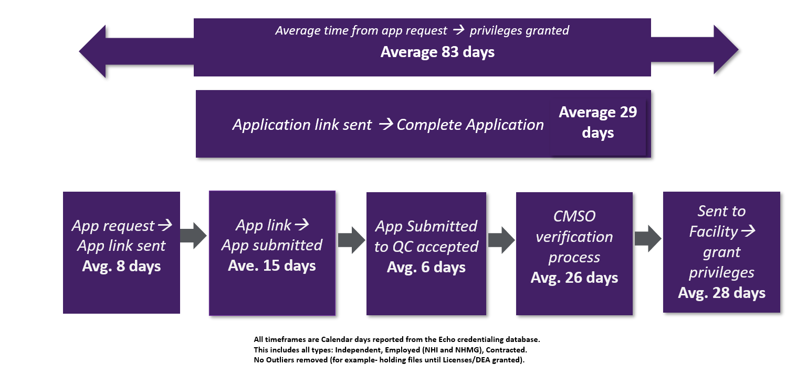
The What, When and Why- The Remarkable Onboarding process

Slide 12
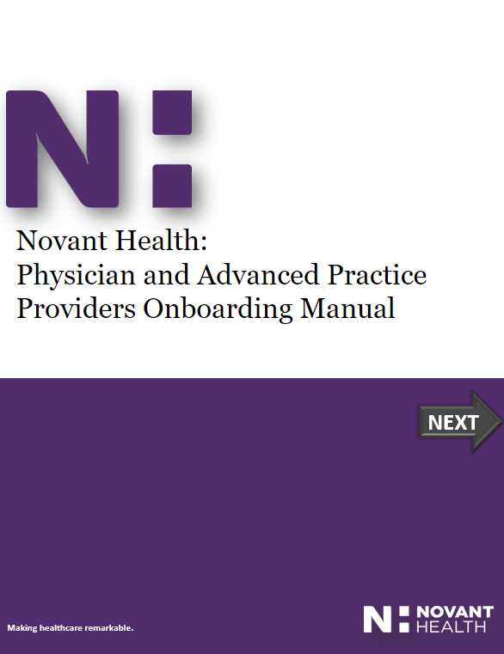
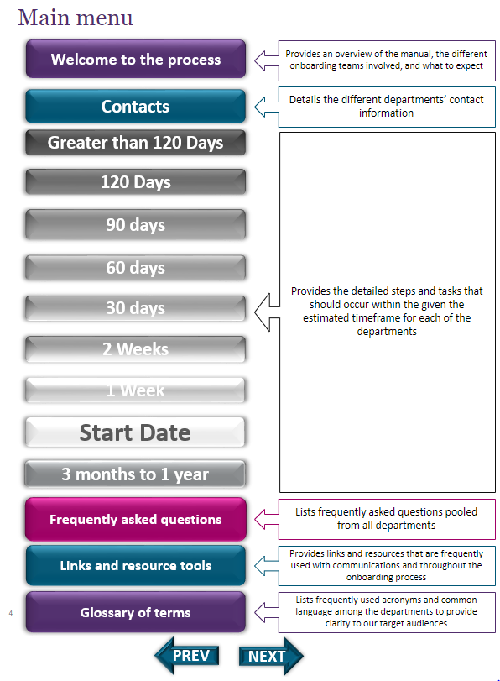
The How - Provider Manual

Slide 13
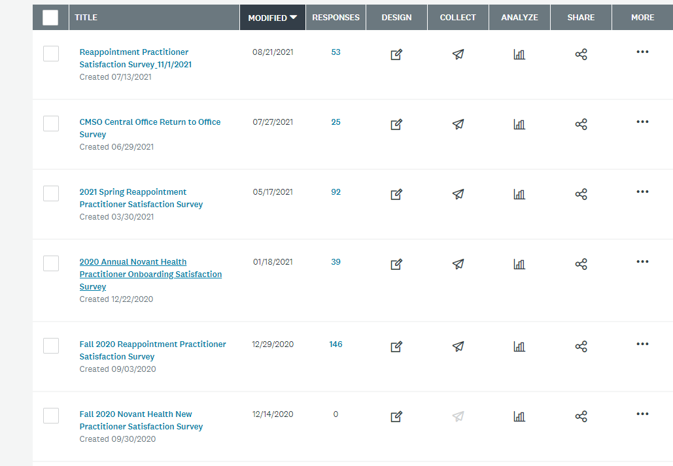
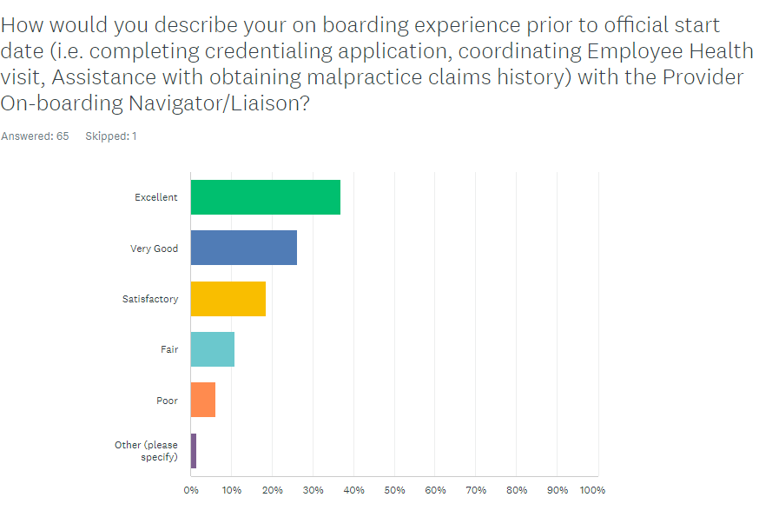
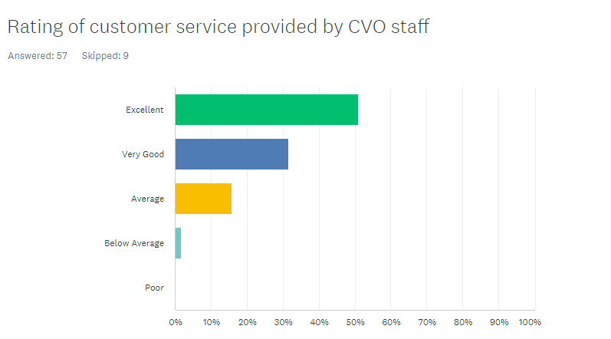
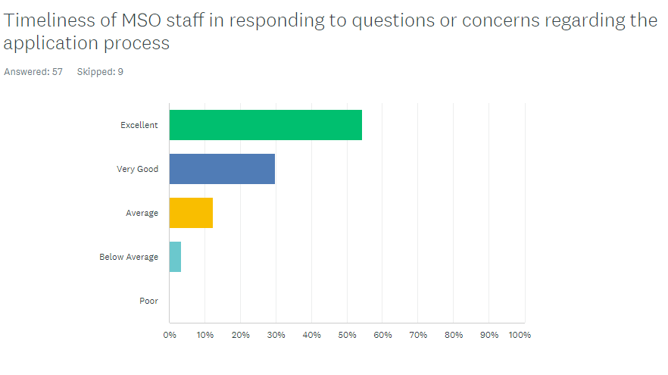
The How – Survey
Frequent process measurements

Slide 14





Partnership Development
Notes:
Synergies developed
Provider Onboarding Manual
Clinic Admin Checklist
Quick Applicant Status Calls (Weekly)
Process Improvement Calls (Monthly)
Regular Process Mapping Connections

Slide 15




Expanding the Partnerships
Notes:
Provider Enrollment
Corporate Insurance
Badging/Accesses
Human Resources

Slide 16

Expanding the Partnerships – who else?
Notes:
Who else can we partner with?

Slide 17
















































































Closing Credits- Here is to all the partners involved in Onboarding practitioners.

