Slide 1
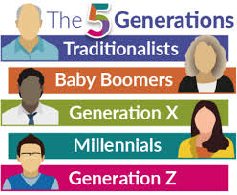

“why can’t we just get along”
Working with PEOPLE
S
B
&
B
John Pastrano, bba, cpmsm, cpcs
5 Generations Will be Working Together

Slide 2

objectives
Identify and contrast generational differences
Recognizing why my thinking and processing style is different
Accepting the same result with varying approaches

Slide 3

Generational gap
A generation gap or generational gap is a difference of opinions between one generation and another regarding beliefs, politics, or values. In today's usage, generation gap often refers to a perceived gap between younger people and their parents or grandparents.

Slide 4
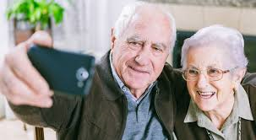
Generational differences
Traditionalists – Born 1945 or before
Veterans, Silent, Moral Authority, Radio Babies, The Forgotten Generation
Raised by parents that just survived the Great Depression
Experienced hard times while growing up which were followed by times of prosperity

Slide 5
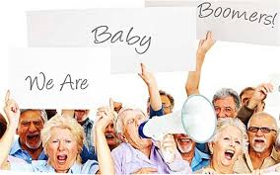
Generational differences
Baby Boomers – Born between 1946-1964 – currently between 57-75 years old (71.6 million in the US)
“Me” Generation, Moral Authority
Highest divorce rate and 2nd marriages in history
Post War Babies grew up to be radicals in the 70’s and yuppies in the 80’s
“The American Dream” was promised to them as children and they pursue it. As a result they are seen as being greedy, materialistic and ambitious.

Slide 6
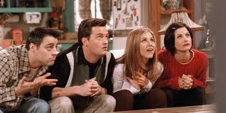
Generational differences
Generation X – born between 1965-1979/80 and is currently between 41-56 years old )65.2 million in the US)
Gen X, Xers, The Doer, Post Boomers, 13th Generation
Their perceptions are shaped by growing up to take care of themselves early and watching their politicians lie and their parents get laid off.
Came of age when USA was losing its status as the most powerful and prosperous nation in the world.
The first generation that will NOT do as well financially as their parents did.

Slide 7

Generational differences
Millennials or Gen Y – born 1981–1994/6 and currently between 25 and 40 years old (72.1 million in the US)
Generation Y, Gen Y, Generation Next, Echo Boomers, Chief Friendship Officers, 24/7’s
Typically grew up as children of divorce
They hope to be the next great generation and to turn around all the “wrong” they see in the world today
They grew up more sheltered than any other generation as parents strived to protect them from the evils of the world
Came of age in a period of economic expansion
Kept busy as kids
First generation of children with schedules

Slide 8
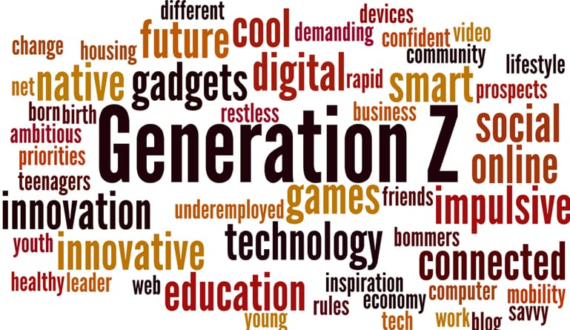
Generational differences
Centennials or Gen Z – born 1997–2012/15 and currently between 6 and 24 years old (nearly 68 million in the US)
Digital Natives: While Millennials grew up in a technologically savvy and connected world, younger members of Generation Z cannot remember a world without the Internet. They grew up swiping an iPad before they learned how to talk and are the first generation to be raised in the era of smartphones. Teenage members of Gen Z are connected nearly every waking hour of the day.
Entrepreneurial: Gen Zers have been raised with businesses such as Uber and airbnb, seeing how easy and simple it is to use your own time and resources to make money. 72% of older members of Gen Z want to start their own business.
Less Religious Identification: In 1966, 6.6% of incoming freshman reported being unaffiliated with any religion. In 2015, nearly one-third (29.6%) of all incoming college students reported not identifying with any particular religion. The question is whether young people today are truly moving away from religion or just defining themselves differently than previous generations. I tend towards the latter explanation, although there is probably some truth in the first.

Slide 9

Generational differences core values
Traditionalists
  Adhere to rules, Conformers, Contributing to the collective good, dedication/sacrifice, delayed reward, discipline, don’t question authority, duty before pleasure, family focus, “Giving Back” is important, hard work, law and order, loyalty, patriotism, patience, respect for authority, responsibility, savers, stabilizing, trust in government
Baby Boomers
  Anti war, anti government, anything is possible, equal rights, equal opportunities, extremely loyal to their children, involvement, optimism, personal gratification, personal growth, question everything, spend now, worry later, team oriented, transformational, trust no one over 30, youth, work, Want to “make a difference”.

Slide 10

Generational differences
Core values
Generation X
  Balance, diversity, entrepreneurial, fun, highly educated, high job expectations, independent, informality, lack of organizational loyalty, pragmatism, seek life balance, self-reliance, skepticism/cynical, suspicious of boomer values, think globally and techno literacy
Millennials
  Achievement, avid consumers, civic duty, confidence, diversity, extreme fun, fun!, high morals, highly tolerant, hotly competitive, like personal attention, self confident, socialability, members of global community, most educated generation, extremely techno savvy, extremely spiritual, now!, optimism, realism and street smarts

Slide 11
Generational differences
Workplace Characteristics | Traditionalists (1922-1945) | Baby Boomers (1946-1964) | Generation X (1965 – 1980) | Generation Y (1981 – 2000)
Work and Ethic Values | Hard work Respect authority Duty before fun Adhere to rules | Workaholics Work efficiently Crusading causes Desired Quality Personal fulfillment Question authority | Eliminate the task Self-reliance Want structure and direction Skeptical | What’s next Multitasking Tenacity Entrepreneurial Tolerant Goal Oriented
Work is… | An obligation | An exciting adventure | A difficult challenge A contract | A means to an end Fulfillment
Leadership Style | Directive Command–and- control | Consensual Collegial | Everyone is the same Challenge others Ask why | *TBD
Interactive Style | Individual | Team player Loves to have meetings | Entrepreneur | Participative
* As this group has not spent much time in the workforce, this characteristic has yet to be determined.

Slide 12
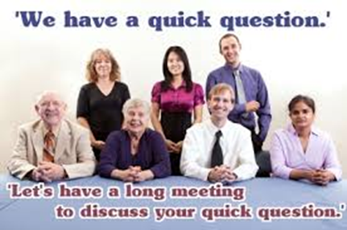

Generational differences
Workplace Characteristics | Traditionalists (1922-1945) | Baby Boomers (1946-1964) | Generation X (1965 – 1980) | Generation Y (1981 – 2000)
Communications | Formal Memo | In person | Direct Immediate | Email Voice Mail
Feedback and Rewards | No news is good news Satisfaction in a job well done | Don’t appreciate it Money Title recognition | Sorry to interrupt, but how am I doing? Freedom is the best reward | Whenever I want it, at the push of a button Meaningful work
Messages That Motivate | Your experience is respected | You are value You are needed | Do it you way Forget the rules | You will work with other bright, creative people
Work and Family Life | Ne’er the twain shall meet | No balance Work to live | Balance | Balance
https://www.slideshare.net/JohnnySchaefer/generations-workplace-characteristicspdf

Slide 13
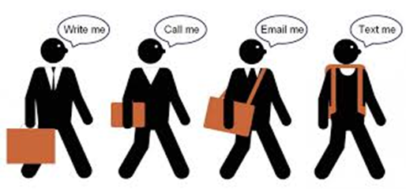

Generational differences
Biggest Variance – Communication Style
  Write me a letter
  Call me on the phone
  Email/Text
  Social Media/Text

Slide 14
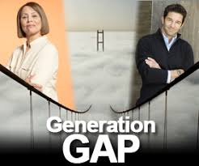

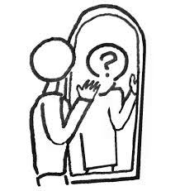
Generational differences
Regardless of Generation – Who am I?
  Passionate
  Loyal
  Determined
  Get things done
  Make things happen
  Early in, last out
  Not Type B, not Type A but Type MSP

Slide 15
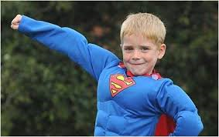
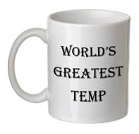
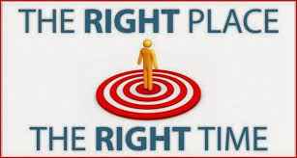

My thinking and processing style is different
How did I start in the world of credentialing?
  I wanted to do this when I was 7 years old
  I was asked to help/fill in for a short period
  Right place at the right time
  No one else to do it so it was given to you

Slide 16




My thinking and processing style is different
Where I came from
  Environment
  Education
  How you started in the business
  What inspires you

Slide 17
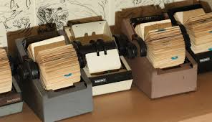
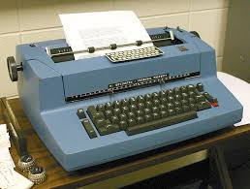
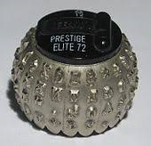

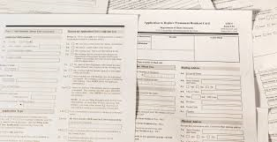




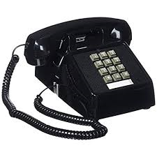
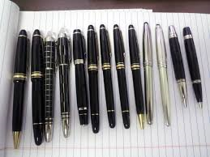
My thinking and processing style is different
I remember when…
  All information was on a rolodex
  Forms letters and Selectric Typewriter
  NPDB – long form on NCR paper
  NO mistakes
  NO white out
  Mail for primary source verifications – foreign grads

Slide 18
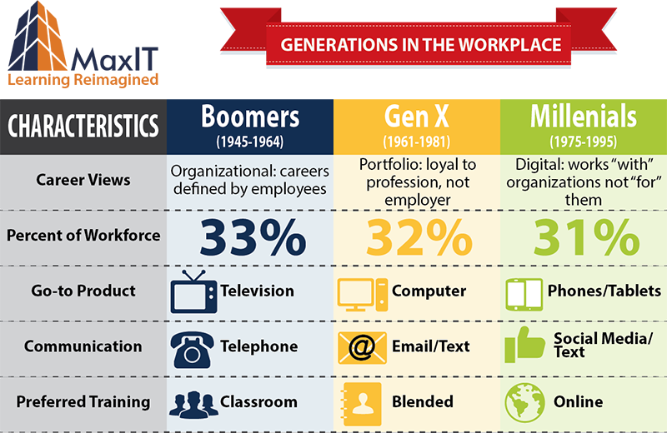
Generational differences

Slide 19
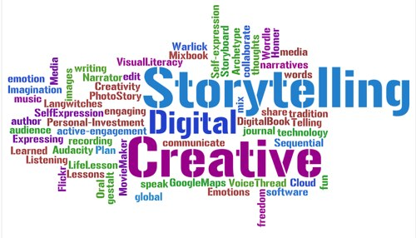
What should we do at work?
Openly discuss the stereotyping and meta-stereotyping of the various generations at work
  Role reversal exercises
  Advantages of age-diverse group
  Sharing of stories

Slide 20
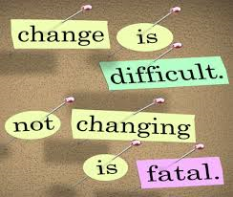
My thinking and processing style is different
Change is Productive
  Recognizing Change is positive
  Acceptance of Change
  Time to Change

Slide 21

My thinking and processing style is different
The Interview – Youtube – A Millennial Job Interview
Disclaimer – this is a video that does not truly define everyone

Slide 22
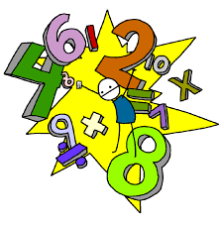
Accepting varying approaches
How much is 5 + 4 = ?
How much is 6 + 3 = ?
Are the totals the same?
What is the difference between the totals?

Slide 23
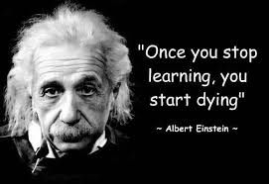

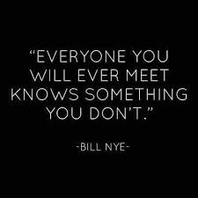
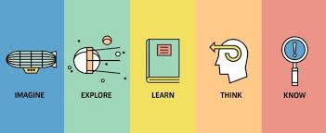
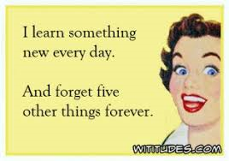
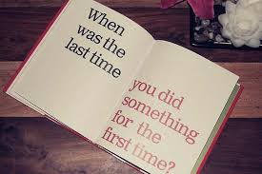

Accepting varying approaches
Learn something new
Take a new route
Try new food

Slide 24
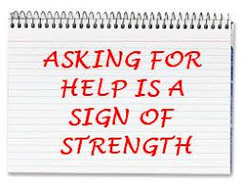
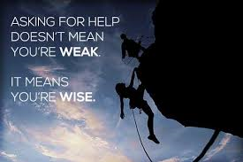

Accepting varying approaches
Recognize your release of control
Delegate
Ask for assistance or opinions
Bridge the gap

Slide 25

Accepting varying approaches
Recognize the end result and various means to achieve
Understand the individual
Embrace the ingenuity

Slide 26
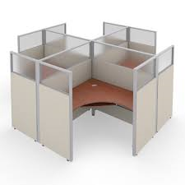
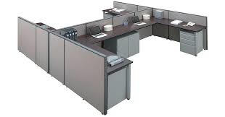
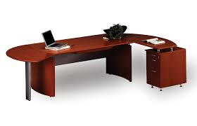
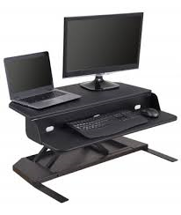

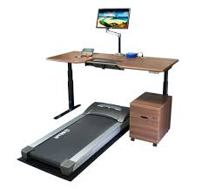
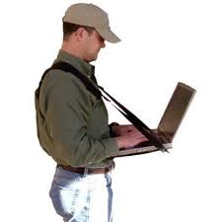
Accepting varying approaches
Trending
  Cubicle
  Desk
  Office
  Open cubicle concept
  Lap top and docking station
  Elevated desk
  Lap top Strap

Slide 27
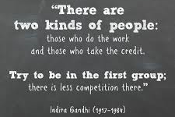
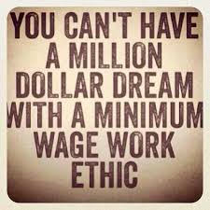
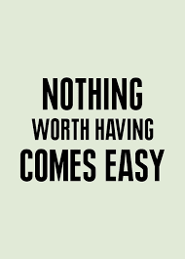
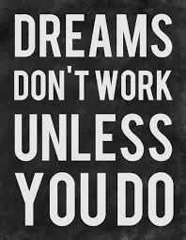
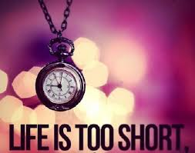
Accepting varying approaches
You own your own destiny
Reputation
Work ethic
Time is too short

Slide 28

Consideration questions
What do you see as the greatest strengths of your generation?
What do you think are the greatest weaknesses of your generation?
What do other generations misunderstand about you?

Slide 29

Consideration questions
What do appreciate about other generations?
What have you learned from people in your life who are from other generations?

Slide 30

Consideration questions
Is there anything about the successes and failures of older generations that sheds light on where you are?
What do you think are the best ways to connect withy you and your peers?

Slide 31

In summary
We are all different but the same
We want the best for our patients/members
Have the same passion and drive for credentialing

Slide 32

THANK YOU!
Contact Information:
John Pastrano, BBA, CPMSM, CPCS
Southern Belles and Beau Speaker Bureau

