Slide 1


FPPE/OPPE
APP’s
2021
NC NAMSS
May 13, 2021

Slide 2

Joni Orand
28 year career in healthcare
  Both managed care and hospital environments
Degree in Corporate Communications
Minors
  Interpersonal Communication
  International Studies in Communications
Certified trainer, speaker, and coach
Quality Experience:
  Educating
  Consulting/SME
  Supporting
SENIOR SOLUTION
CONSULTANT

Slide 3
FPPE/OPPE APP’s 2021
Today we will learn
Define what constitutes a compliant evaluation process
Discuss peer references for Allied Health Pros
Identify Common Pitfalls of FPPE/OPPE and prevention

Slide 4
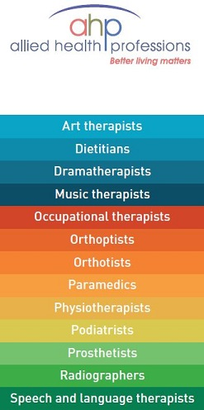
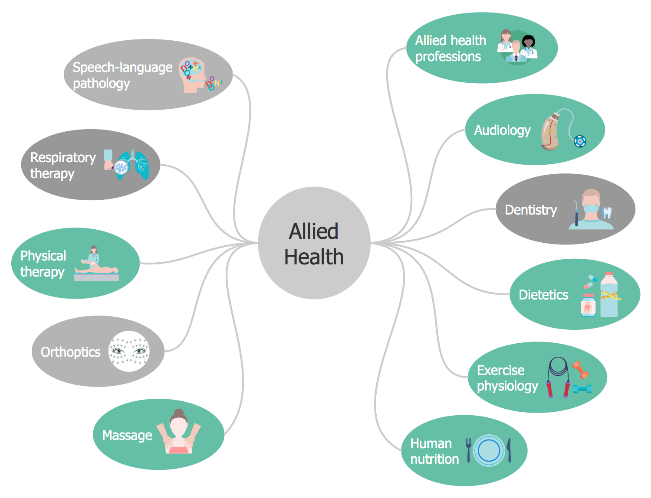
Examples of APP’s

Slide 5


Compliant Process
Yes. You must predefine the FPPE/OPPE process according to bylaws, guidelines, policy and procedures.
If an organization's current "peer review" process includes the criteria to be used for identified performance issue, defined triggers that indicate the need for performance monitoring and required components it would meet the intent for the existing focused professional practitioner evaluation.

Slide 6
What about Allied Health?
Not specifically addressed in any of the standards specifically.
Most if not all are sponsored by a physician in most healthcare settings.
Who do you rate them against?
Physician- can’t they get a pass ?
What competencies do we use?
There are five million allied health care providers in the United States, who work in more than 80 different professions and represent approximately 60% of all health care providers. The number of allied health care providers is likely to grow as jobs in the health care industry will grow from 15.6 million to 21 million between 2010 and 2021.
Be sure to describe the process in your by-laws as well as policies and procedures. Surveyors want to ensure processes are well documented and established plans are adhered to.
Choose meaningful measures that accurately reflect AHP performance. Taking the time to determine important measures related to your providers may be time consuming on the front end, but once complete the results are worth it.

Slide 7

Importance of FPPE
What is FPPE?

Slide 8
Focused Professional Practice Evaluation
Since the outcome of the FPPE is so important, the review, decision and follow-up process developed by the hospital – usually at the department level –
must be objective and capable of accurately determining when a clinician’s performance is falling below an acceptable norm.
To accomplish this goal, it is important that a
thorough and thoughtful process be developed by each department with substantial input from peers.

Slide 9
FPPE APP
MS.08.01.01 The organized medical staff defines the circumstances requiring monitoring and evaluation of a practitioner’s focused professional performance evaluation (FPPE)
Medical Staff Services-Focused Professional Practice Evaluation means a structured and time-limited evaluation of the competence of a practitioner to safely exercise a clinical privilege or set of privileges.
FPPE is performed at the time of initial appointment to the clinical staff;
upon the request of a new privilege, if the practitioner cannot provide prior documentation of competence to perform the requested procedure;
or when a question arises regarding the ability of a currently privileged practitioner to competently and safely exercise the privileges he or she is currently granted
CMS Requires-Follow State Laws! Licensure, current work practice, special education or training, quality of work, outcomes, NPDB review, compliant with state and local as well as bylaws, log of CME.
Member of Medical Staff and/or performs procedures attached to a code
CMS, TJC, State Regulations, HFAP for requirements
Any OPPE triggers or prolonged absences
Clear guidelines/benchmarks and method for establishing monitoring and duration of performance monitoring, circumstances where monitoring is now required. (for cause FPPE)
Not every Privilege procedure applies across the board
Evaluators signature required/sign off
WHO, WHERE and HOW for Improvement? What happens if they fail?

Slide 10
Importance of OPPE
What is OPPE?

Slide 11
Ongoing Professional Practice Evaluation
OPPE- Joint Commission
§ 482.22(a)(1)
The medical staff must periodically conduct appraisals of its members
MS.08.01.03 Ongoing professional practice evaluation (OPPE) information is factored into the decision to maintain existing privilege(s), to revise existing privilege(s), or to revoke an existing privilege prior to or at the time of renewal

Slide 12
OPPE FOR APP’s
Fair, standardized and consistent process!
More than one method for review (not just chart review)
Practice or specialty specific in comparisons
Look at trends and patterns
Triggers (meaningful) with criteria of acceptability/Rule variations
Data:
HCAPS
Core measure data
Blood usage
Prescribing
LOS, Mortality and Re-Admission (six standards)
Peer benchmark or ICD/CPT Procedure codes
DRG/grouped privileges must be evaluated separately
A privilege/procedure must be assessed by specialty and held to same standard for evaluation (central line)
Telehealth-Covid

Slide 13




SIX CORE COMPETENCIES
PATIENT CARE
Has the AHP been referenced in the patient satisfaction surveys?
Are there any compliments or complaints?
MEDICAL/CLINICAL KNOWLEDGE
Has a supervisory or collaborating provider indicated a concern?
Has the AHP been reviewed in the Peer Review committee ever indicated a concern?
What does a review of the chosen patient assessment and treatments say about the competency of the AHP?
PRACTICE BASED LEARNING/IMPROVEMENTS
Does a chart review indicate a working knowledge of current scientifically based treatment choices?
Is the AHP involved in on-going educational opportunities

Slide 14



SIX CORE COMPETENCIES
INTERPERSONAL & COMMUNICATION SKILLS
How does the AHP function in a team setting?
Compliments and Complaints
Do they take feedback/direction well
SYSTEM BASED PRACTICE
This can be ascertained from a chart review and study of the treatment choices and care plans created for patients treated. Is the practitioner able to see past an individual episode of care and evaluate the family, the community and other bodily systems and their contribution to the current state of the patient?
PROFESSIONALISM
This area can be assessed by evaluating the overall impression made by this practitioner in all other competency areas. It is the sum of all parts.

Slide 15

What about individualization?
An evaluation should also include a minimum of:
Two “hospital specific” monitors meeting core competencies
Two “department specific” monitors.
These can be the same for AHP’s as well as Physicians to simplify the processes.
American Academy of Physician Assistants- AAPA.org website for examples

Slide 16
OPPE for APP’s
https://www.aapa.org/download/68765/
Explanation, checklist and more detail around competencies

Slide 17




Why FPPE/OPPE?
    Reality and Statistics
    Risk/Liability
      Provider Retention and Buy In
    Allied Health FPPE/OPPE
Notes:
There is a decided shift from volume to value, which will accelerate in light of recent government announcements regarding Medicare payments – by 2018, government expects 90% of Medicare FFS reimbursement linked either to value-based purchasing or to some sort of quality measure. And the consumer’s role is evolving as they take on more of the financial responsibility and as they are asked to engage in the process of managing their health and well being. This shift varies tremendously by region and market, highly dependent on the competitive and payer dynamics in your particular geography.
A second important shift that is occurring, mostly as a result of this shift from volume to value, is the need to become a low cost, high value provider. To be included in networks, providers will need to transform and prove value—demonstrating that they can deliver high quality, evidence-based care while managing or reducing the cost of care. And they must be able to do this not only when delivering episodic care but also demonstrate that they can manage population health in a cost-effective manner.
There is also a shift occurring in the way you interact with your physicians, whether they are employed or independent. Giving physicians what they wanted — such as access to the operating room and a supportive nursing staff — is what drove good business. And it still is very important. Now, however, there is an opportunity through physician engagement — whether with employed or independent physicians — to improve patient access, customer service, quality and costs. Establishing a highly engaged physician population allows hospitals to more effectively target the quality and efficiency issues that may help reduce complications, mortality, readmissions and length of stay. It allows the whole hospital business to come together as a team and tackle inefficiencies while addressing the needs of the community and making the patient experience more satisfactory.
And finally, there is a shift, and it has been underway for some time now, away from traditional models of care to delivery of care across a variety of settings (pharmacies, retailers, urgent care, telemedicine) by different types of care deliverers (nurses, pharmacists, mid-level providers.) People have more choice in where they get health care, and more accountability for the financial implications of those choices than ever before. As a health system leader you’ll need to decide if these alternative delivery settings will be competitors or partners…or perhaps both.

Slide 18

The Reality

Slide 19

“
an ounce of prevention is worth a pound of cure
Benjamin Franklin

Slide 20
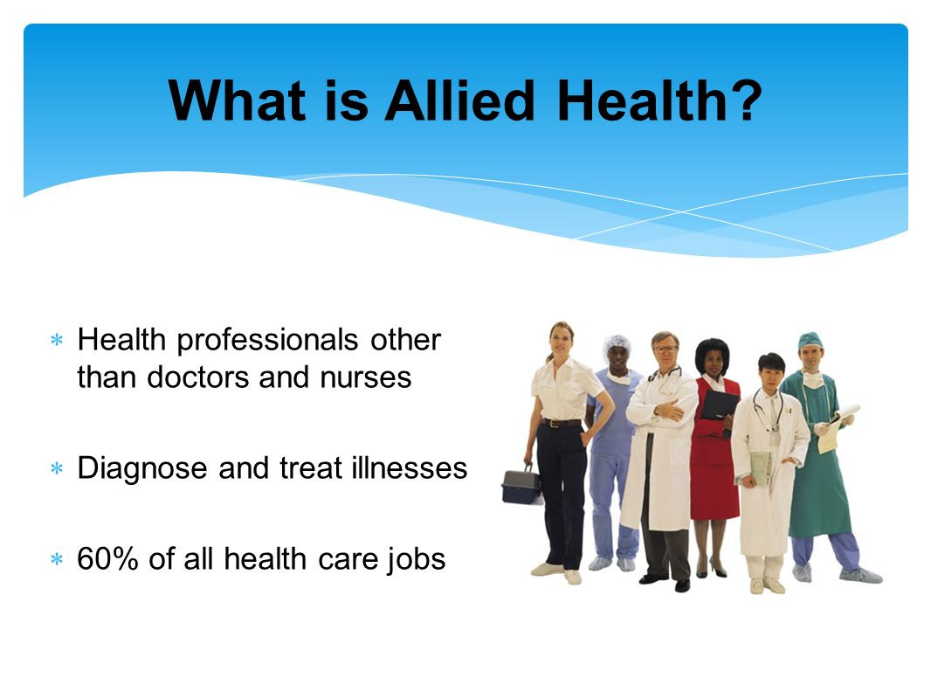
2021 New Year, Same stories
1999 - over 98,000 hospital deaths annually. 2017- about 251,000 hospital deaths annually.
2017 - Approximately 440,000 patient care harm and medical malpractice deaths and this is still rising.
2018 - 250 physicians and APP “state hopped” successfully and those were just the ones they found through lawsuits.
2020- Numbers continue to climb….. in the US hospital deaths are over 500 times higher than accidental gun shot deaths.
2021-Deaths or harm still increasing and those attributed to COVID may include medical error.

Slide 21
How FPPE for cause can prevent liability and risk for the organization, law suits and sentinel/adverse events
Protecting the organization

Slide 22


RISK AND LIABILITY
?
?
Risk
Safe

Slide 23

NOT ONLY PHYSICIANS
90 million a year in nurse malpractice cases
Suspended nurse in Wisconsin charged with 19 counts of NICU patient abuse; A suspended nurse at Madison, Wis.-based UnityPoint Health-Meriter Hospital has been charged with 19 counts related to abuse in the neonatal intensive care unit, WMTV reports.

Slide 24
CAN APP BE SUED?
In law, malpractice occurs when a trained professional “… fails to exercise the degree of care and skill that a similarly situated professional of the same specialty would provide under the circumstances.” Under this definition, not only doctors but other professionals performing care and procedures apply.
In healthcare, the “medical professions” are usually defined as medicine, nursing (RN only), and pharmacy. More recently a separate classification, “Allied Health Professional/Advanced Practice Providers” or “Para-professional” has emerged to include other healthcare workers such as Physician’s Assistants, Nurse Practitioners, x-ray and lab technologist, dietitians, and therapists that work in support of medical professionals. Under the Law of Tort (“negligence”), non-physician medical professionals and para-professionals can be sued if they commit an act that a similarly-trained and experienced worker would not have committed and that act resulted in an injury to a patient. Note that the malpractice must have caused an injury: if no injury occurs, then there is no legal ground for a lawsuit.

Slide 25
Example of Damages Awarded
In a California case, a woman fell and suffered injuries that included a fracture of the radius bone that involved her right wrist and she was referred to a private orthopedic group for treatment. At that practice, she was seen by a Physician’s Assistant (PA) who, over the next five months, unsuccessfully treated the woman with manual realignments of the fracture and casts. After five months without improvement, the PA consulted a physician in the same orthopedic practice. This physician “admonished” the PA and recommended immediate surgery. The women filed a malpractice suit against both the PA and the orthopedic practice were awarded $552,000 in damages after a jury trial.
A 42-year-old woman went to a medical clinic complaining of generalized weakness and occasional fevers of 102⁰. She was seen by a Nurse Practitioner (NP) who diagnosed influenza. Over the next two weeks, she made repeat visits to the NP with the same complaints, which the NP dismissed as due to obesity and probable premenopausal in nature. Worsening symptoms sent the woman to the local ER, where she was diagnosed with endocarditis, an infection of a heart valve. After undergoing heart surgery, the woman was rendered a near-invalid due to blood clots that traveled from her heart to her brain before her surgery. The woman sued the NP and the clinic’s supervising physician alleging that failure to properly diagnose directly lead to her becoming a virtual invalid. Her lawsuit was settled out of court for a reported $1 million.

Slide 26





Common mistakes can be included in provider evaluation
Pointing to the increasing cost - as much as $236 billion in unnecessary health care expenses annually due to the inability of patients to understand what medical providers are communicating to them - the Institute for Healthcare Advancement (IHA) has created a new list of the 10 most common errors providers make when communicating with patients.
They are:
Creating prescription drug instructions that are written at 11th grade reading level or higher, rather than 5th grade reading, the level at which the majority of the country's population reads
Communicating in medical jargon when it's not necessary. For instance, using terms like "otitis media" and "myocardial infarction" instead of "ear ache" and "heart attack" when informing patients of their condition unnecessarily complicates clear communication
Sending patients to the Internet as a means of better explaining instructions and follow-up care. This is a problem when healthcare professionals may be sending patients to sites that provide information that is not in agreement with their advice, or when it is not clear the patient has access to the Internet
Handing out reading material that is printed in a font size too small for the patient - particularly seniors, the country's largest patient population - to read. Type should be at least 12 point with adequate leading (space between lines)

Slide 27
Common mistakes can be included in provider evaluation
Not using simple visuals for medical instruction which can enhance patient understanding. Graphics should demonstrate and explain concepts in the text, and should never be abstract or for ornamental purposes only
Not recognizing that a patient's response of "yes" or a simple nod might mean the patient is merely being polite but actually does not understand what they have just been told. Providers should ask patients to explain to them in their own words, or "teach back," the concepts just discussed, so the provider is certain the patient understands
Failing to demonstrate cultural awareness and sensitivity in patient encounters. Many cultures have different norms than those of the provider, and these norms should be honored wherever possible.
Talking too quickly to the patient and not allowing time for the patient to ask questions in response
Not providing medical information in the patient's first language
Not taking time to explain the meaning of prescription bottle labels such as "TAKE WITH FOOD." Studies show that even simple labels such as this, written at a 1st or 2nd grade reading level, are not understood universally as people have stuffed pills into solid foods and then eaten the food without liquid.

Slide 28
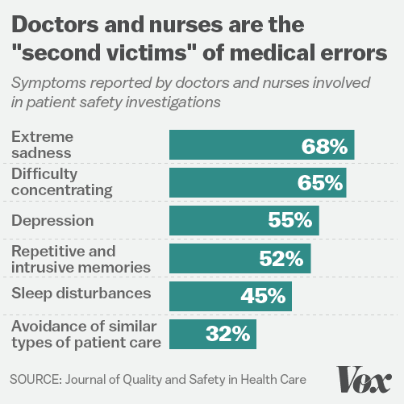
APP Retention and Buy-In
App’s lawsuits against hospital rising! 2020

Slide 29

Factors to take into consideration
Burnout- Emotional exhaustion, Cynicism, Efficacy
Work Engagement-Vigor, Dedication, Absorption
Empowerment- Competence, Meaning, Self-determination, Impact
Problem solving
Mental Health-Behavior, professionalism, relationships
Leadership-formal and informal
Orientation and training
Support/Culture
Violence against APP’s on the rise
Abuse or neglect of patients
Value Based Care and Payment

Slide 30

Tips for preforming the FPPE/OPPE for Allied Health
Keeping watch

Slide 31
FPPE/OPPE Physician Extenders
Should contain a dynamic process of checks and balances
Measure a system of care that‘s current, data driven, evidence based and controlled
The process of collecting and evaluating data is often captured differently.
    Be based on data/changes from last OPPE
Notes:
There is a decided shift from volume to value, which will accelerate in light of recent government announcements regarding Medicare payments – by 2018, government expects 90% of Medicare FFS reimbursement linked either to value-based purchasing or to some sort of quality measure. And the consumer’s role is evolving as they take on more of the financial responsibility and as they are asked to engage in the process of managing their health and well being. This shift varies tremendously by region and market, highly dependent on the competitive and payer dynamics in your particular geography.
A second important shift that is occurring, mostly as a result of this shift from volume to value, is the need to become a low cost, high value provider. To be included in networks, providers will need to transform and prove value—demonstrating that they can deliver high quality, evidence-based care while managing or reducing the cost of care. And they must be able to do this not only when delivering episodic care but also demonstrate that they can manage population health in a cost-effective manner.
There is also a shift occurring in the way you interact with your physicians, whether they are employed or independent. Giving physicians what they wanted — such as access to the operating room and a supportive nursing staff — is what drove good business. And it still is very important. Now, however, there is an opportunity through physician engagement — whether with employed or independent physicians — to improve patient access, customer service, quality and costs. Establishing a highly engaged physician population allows hospitals to more effectively target the quality and efficiency issues that may help reduce complications, mortality, readmissions and length of stay. It allows the whole hospital business to come together as a team and tackle inefficiencies while addressing the needs of the community and making the patient experience more satisfactory.
And finally, there is a shift, and it has been underway for some time now, away from traditional models of care to delivery of care across a variety of settings (pharmacies, retailers, urgent care, telemedicine) by different types of care deliverers (nurses, pharmacists, mid-level providers.) People have more choice in where they get health care, and more accountability for the financial implications of those choices than ever before. As a health system leader you’ll need to decide if these alternative delivery settings will be competitors or partners…or perhaps both.

Slide 32
PEER REFERENCES
MS.07.07.03 Element of Performance 2 states that you only need to get and evaluate peer recommendations at reappointment if you have insufficient practitioner-specific data. Many facilities, however, continue to rely heavily on peer references as a means of collecting quality information. Is this reliance based on fact or habit? Let's examine TJC's current peer reference requirements.
First, who may be a peer? This question comes up frequently and there is great variation in the answer even among our hospital clients. According to the Joint Commission, a peer is someone from the same discipline with essentially equal qualifications. For example, a nurse practitioner’s peer reference would ideally come from another nurse practitioner who is familiar with the individual’s actual performance, either from within the same organization or outside the organization. TJC continues:
“However, in situations where there is no nurse practitioner, physician’s assistant, psychologist, or social worker who could provide a peer reference it is acceptable for a physician or D.O. with essentially equal qualifications, who is familiar with the allied health practitioner’s performance, to provide the reference. For example, an anesthesiologist could provide a reference for a nurse anesthetist, and a psychiatrist could provide a reference for a psychologist and a psychologist with similar responsibilities could provide a reference for a social worker.”
From http://www.jointcommission.org/AccreditationPrograms/Hospitals/Standards/09_FAQs/MS/Peer_References.htm

Slide 33
PEER REFERENCES
“Peer References” are reviews of the provider’s skills and experience by the candidate's colleagues. They are used to evaluate the provider’s current competence during the application process. The standard requirement across most healthcare facilities is three professional peer references, but the number may vary based on each facility’s bylaws
The references must be written documentation that document the provider’s general competency assessment:
Medical/clinical knowledge
Technical and clinical skills
Clinical judgment
Interpersonal skills
Communication skills
Professionalism
Leaders and Peers may not understand the process. Give them a quick and easy way (checklist to fill out)
Three peer references is ideal

Slide 34
PEER REFERENCE
The process is straightforward like the other document collections, but it’s a bit trickier since you’re dependent on other people to complete something and get it back to you:
1. Confirm that the provider’s peers are willing to submit a Peer Reference
2. Send out Peer Reference forms to the peers
3. Collect completed Peer References”
WHO CAN SUBMIT A PEER REFERENCE? HOW DO YOU IDENTIFY THEM?
“The providers should provide names and contact information in the Peer References section of the application. They should have given a heads up to the individuals listed as references. The written references are confidential, so providers should never get their hands on completed references.
They should be individuals who have worked with the provider within 2-3 years to keep the references as current as possible. two or all of the references are usually doctors who have worked with the applicant in the same specialty, but one can be other knowledgeable professionals. They can be supervisors, medical directors, or other individuals who have observed the applicant’s performance and can evaluate the six areas.”

Slide 35
PEER REFERENCE
WHAT DOES A PEER REFERENCE LOOK LIKE?
“It generally looks like a questionnaire with close-ended and open-ended questions. The scaled questions may have 3-5 options for you to circle like ‘below average, average, and above average.’
The peers need to answer questions about their familiarity and relationship of the applicant like: How long have you known them? What have you seen them practice? What kinds of facilities have you seen them practice in?
The completed review must be signed and dated by the reference. They’ll also have an opportunity to leave any additional comments.”

Slide 36
PEER REFERENCE
WHEN SHOULD I START THE PEER REFERENCES PROCESS?
“I encourage every credential manager to begin soon as you can! Once you get the names in the application, start reaching and sending the forms to them immediately.
Starting early will give you a cushion when the peers take longer than expected to get them back to you. From my experience, it’s taken on average 2-4 weeks to receive the completed references back, but it can be pretty scattered. It’s the longest and probably the most frustrating process.”
THE MOST DIFFICULT PART OF THE PEER REFERENCES PROCESS?
“Receiving them back. I’ve dealt with the burden of peers who ended up unresponsive or were extremely slow to respond. In those cases, it helps to offer them multiple forms of communication instead of limiting it to just mailing by envelope.
Emailing and faxing allows the individual to send the completed reference back with less delay, but I recommend using a credentialing software that facilitates the Peer References process from the very beginning. It’s more secure and expedites the process.”
**Please note, too, there is no TJC requirement that a physician must be in the same specialty to serve as a peer evaluator. Any requirement that peers much be in the same specialty is voluntary – and beyond actual TJC accreditation requirements. For small hospitals or facilities in rural areas, it may be impossible to find another specialist, particularly one who is not in direct competition, who can comment on the physician’s actual clinical knowledge, technical skills, judgment, interpersonal skills, communication, and professionalism. Also, a thoughtful peer evaluation of a surgeon might come from an anesthesiologist who personally witnessed the surgeon’s surgical skills in the operating theater than a partner or other member of the surgery department who does not have this direct knowledge of the surgeon’s skill and judgment. Again, the decision regarding who may serve as a peer reference is within the medical staff’s discretion.

Slide 37
OPPE for APP Tips
Like background or experience
Nurse supervisors or managers are okay as well as physicians
Observation, patient feedback/experience
Collaborating or Supervisory
No data is okay- use other resources, no data can be data as in “no complications” or any negative. Explanation for no data.
Separate from HR annual reviews
Mix of general and specialty rates
Based on bylaws physician OPPE may be different from APP
Late career or low volume criteria should be included
Courses CE’s do not count as FPPE/OPPE

Slide 38

WHAT IS CLEAR
All standards require your process be delineated in your by-laws including:
Requirements
Timeframes
Intended framework
Measure to be used
How data will be collected
Criteria/triggers for initiating a performance improvement plan
KEEP IT SIMPLE

Slide 39

Finally, FPPE/OPPE is essential for an organization.
Not only at Initial Appointment/Onboarding or Privileging, but ONGOING!
FPPE/OPPE can be a very valuable tool internally as well as for accreditation purposes for prevention.

Slide 40

Symplr and Joni say

