Slide 2
Your Link to MSPs
From Across the Nation

Slide 3
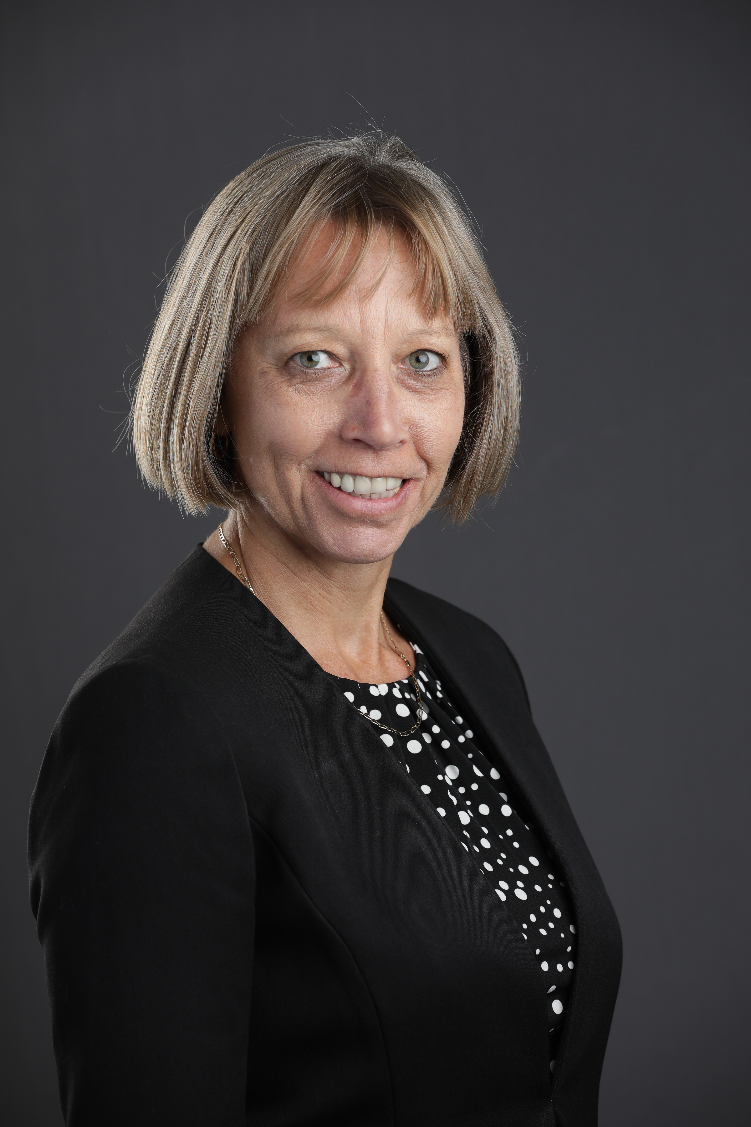
Alison Webster, MBA, CPCS, CPMSM, CPHQ
Director-at-Large,
KY, NC, PA, VA, WV
National Association of Medical Staff Services
Email: Alwebster@salud.unm.edu
Office: 505 272-9441

Slide 4
Learning Objectives
Describe the history of NAMSS, strategic initiatives and impact on the industry.
Identify elements of the NAMSS Leadership and Volunteer Pathways to better support the profession.
Discuss verification benchmarks and grassroots efforts NAMSS is supporting to improve credentialing efficiencies.

Slide 5



History of NAMSS
NAMSS firsts:
  Formed in California in 1971
  National conference held in 1977
  Certification process initiated in 1978
Notes:
History of NAMSS In The 1970s:
Charlotte O. Cochrane along with Joan Covell spearheaded the formation of the Medical Staff Secretaries Association with 20 members, as a forerunner to NAMSS.
18 months later the groups official publication, Overview was born.
The first national conference was held in 1977 in Chicago, Illinois.
In 1978, the certification process was instituted and the articles of incorporation were filed.
The Committee on Continuing Education worked diligently to provide a basis for recognition and achievement for the profession.

Slide 6

History of NAMSS (cont.)
Growth of NAMSS
Membership grew from initially under 60 members to near 2,000 members in 1989.
Membership demographics have changed from primarily traditional hospital credentialing/privileging members to a strong presence of managed care members.
Increasing presence of international members.
New affiliation with the American Health Lawyers Association (AHLA) has also enriched and diversified our membership.
Notes:
History of NAMSS Growth
The new name, “National Association Medical Staff Services” was officially adopted in 1980. Throughout the 1980s, the organization continued gaining national recognition, which led to increased membership, increased conference attendance, and flourishing state associations.
Educational programs have grown out of member type and member needs assessments to include new affiliate programs and designations.
NAMSS has connected with our international colleagues to learn more about them and their needs “how can we help you?”
Reciprocal affiliation membership opportunities with discounted rates have been established between NAMSS and the AHLA
We’ll learn more about AHLA in a little bit

Slide 7
History of NAMSS (cont.)
Partnering with State Leadership
Our Industry Journal was renamed Synergy - new facelift in 2016
Ability to be Dual Certified – became a reality
Education extends to managed care
Leadership Council - journey to leadership
Leadership Certificate program – Fall 2016
State of the Profession Report – 2016
Notes:
In 1989, state presidents came together at the first State President’s Educational Retreat.
In 1998 “Overview” became “Synergy”; and in 2016 “Synergy” got a facelift. We are always encouraging members to submit articles.
Late 90s the CPCS became an additional certification option
In 1994, education was extended to the managed care field
Leadership Council was created in 2000 with a focus on developing leaders, and has continued on this trajectory ever since through the organizations educational programs. New educational modules are introduced at regular intervals
In 2016 the Leadership Certificate program was launched and the State of the Profession Report was released. I’ll share a link to the report in a few minutes.

Slide 8
History of NAMSS (cont.)
NAMSS Increased Technology
NAMSS PASS™ launched in 2013
Synergy and NAMSS Gateway both electronic
Website Updated in 2015
Membership/renewal on-line
Virtual Conference
Mobile App for certification/recertification applications
Notes:
History of NAMSS in The 2010’s:
In 2013, NAMSS PASS was launched.
In 2014 NAMSS published the first issue of NAMSS Gateway which is a monthly electronic newsletter delivering the latest industry updates.
NAMSS also updated its look with a brand new website.
Virtual Conference attracts more attendees each year.
The certification and recertification applications both moved online and the NAMSS association mobile app was launched.

Slide 9
NAMSS Today
  NAMSS Members: 5,500+
  CPCS Certificants: 3,700+
  CPMSM Certificants: 1,700+
Notes:
Today, NAMSS has grown to include over 5,500 Medical Staff Professionals from all 50 states and abroad! NAMSS has instituted a successful Annual Conference that brings its members together for education and networking each fall and has continuously run a print, and now electronic, publication, Synergy, to bring news and education to all members.

Slide 10
What Does NAMSS Do for MSPs?
Serves as the voice of the profession, advocating on behalf of MSPs across the nation
Government Relations & Industry Partnerships
Provides education in support of professional development
Supports state affiliates and associations on the local level
Marketing
Notes:
What Does NAMSS Do For MSPs?:
As you will see from the topics discussed at the annual roundtables that will be mentioned shortly, NAMSS is very committed to Government Relations and Advocacy. NAMSS will continue with these efforts and similar projects to advance the profession and advocate on behalf of MSPs.

Slide 11

Tomorrow’s MSP
Notes:
It’s time to start thinking about the future of your career, and NAMSS is here to help you anticipate and leverage what’s to come for the betterment of you, your department, and the practitioners and patients you serve.
We all see it, change is coming to not only our profession and healthcare, but society as a whole. In this age of automation, AI and telemedicine, how we perform our jobs, interact with patients, practitioners, and our peers is rapidly changing. But what does this mean for MSPs?
NAMSS takes our careers and the direction of the medical services profession seriously. We continue to be committed to education, the profession, and advocating on your behalf to further our ultimate goal of patient safety.
In 2021, NAMSS will continue to provide a roadmap for advancing in your career, along with more tools, more resources, more ways to learn, and everything you need to be the change of the future, all while ensure patient safety stays at the forefront of healthcare.
The medical services profession of tomorrow starts TODAY.
Visit www.namss.org/tomorrowsmsp for tools and resources to share with your teams, and stay tuned for much more information from NAMSS

Slide 12
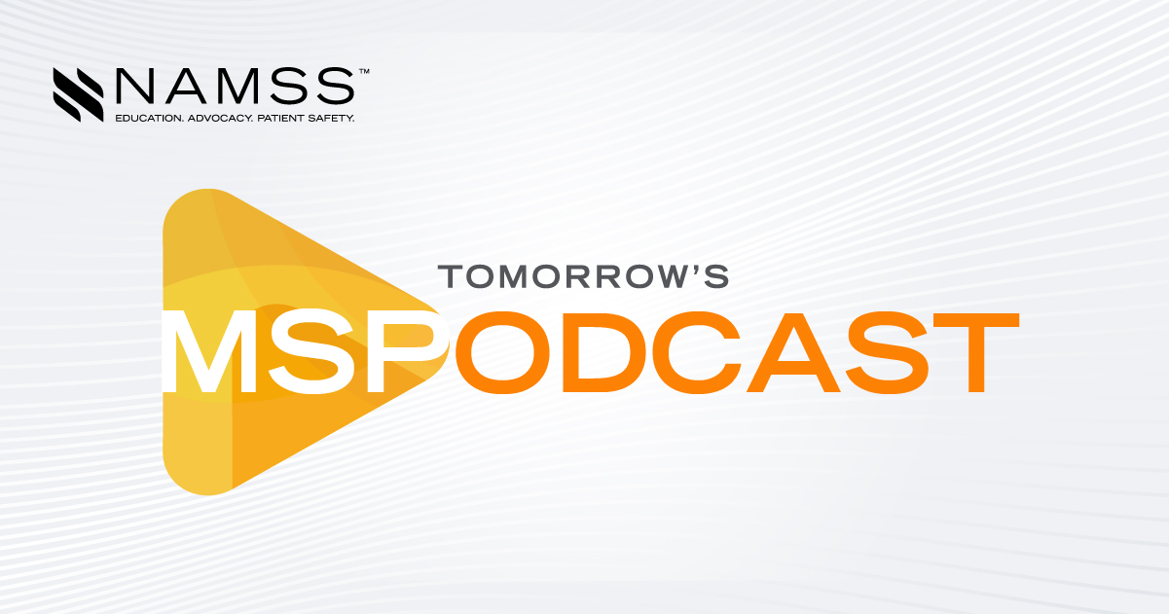

Tomorrow’s MSP
Notes:
In 2020, NAMSS launched a new Tomorrow’s MSP Podcast and MSP Minutes. There were six episodes produced in 2020 with topics ranging from crisis management to advocating for yourself and your department. There will be new episodes monthly, so be sure to check out the NAMSS website.

Slide 13
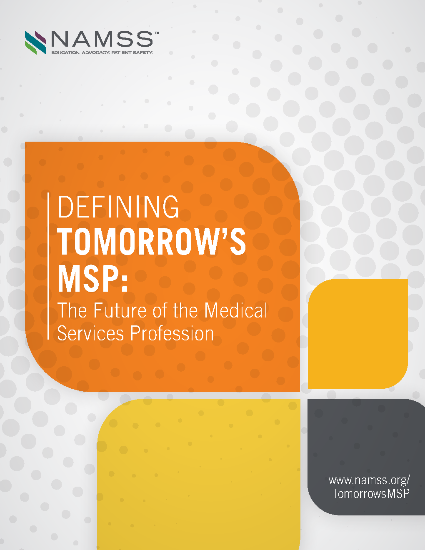
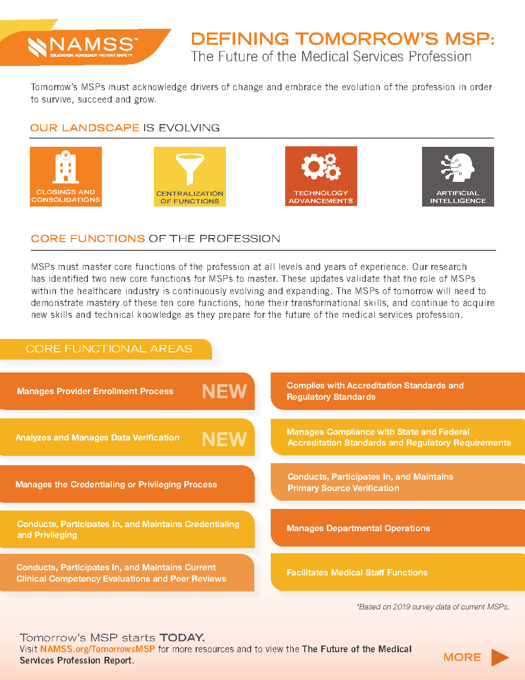
Defining Tomorrow’s MSP: The Future of the Medical Services Profession Report
  https://www.namss.org/Advocacy/Tomorrows-MSP
Notes:
In 2019, NAMSS conducted a study on the current MSP landscape and opportunities for the future, taking a detailed look at the core responsibilities, skillsets, and knowledge as defined by the feedback and responses from MSPs across the country. This data was collected via a NAMSS Job Task Analysis (JTA), NAMSS member surveys, focus groups, and interviews. After more than 18 months of work, NAMSS shared a new pivotal resource for MSPs - Defining Tomorrow’s MSP: The Future of the Medical Services Profession Report. This report outlines how the MSP landscape has changed in the last five years, and how it will continue to change in the next three to five years. This resource will help NAMSS develop training and education to ensure our members are prepared for the future of the profession. The report is accompanied by a fact sheet and both are available on the NAMSS website. Stay tuned for new job description templates to be released early in 2021!

Slide 14
NAMSS Volunteer Path
Notes:
The NAMSS Volunteer Path is a great tool to help you get started on a path to volunteer leadership. Each element has a level; starting with entry level, moving to intermediate, then to advance.
Within each level of each element is a list of activities to help you progress on your path.

Slide 15
NAMSS Volunteer Path (cont.)

Slide 16
NAMSS Volunteer Path (cont.)

Slide 17
NAMSS Leadership Career Path
Element | Entry Level | Experienced | Leadership
Experience | •0 – 4 Years | •5-14 Years | •15 and above
Education | •Associates or Undergraduate Degree | •Undergraduate Degree | •Masters or Doctorate Level
Certifications | •CPCS | •CPCS and/or CPMSM | •CPCS and CPMSM and other healthcare related certifcations (Quality, Risk Management)
Training/Ongoing Education | •Medical Services Professional Education | •NAMSS Leadership Institute •Education on Accreditation/Regulations •Patient Safety and Quality •Risk Management •Six Sigma •Budgets •Finance •Legal •Leadership | •Participate in NAMSS Virtual Round Table
Skills, Knowledge and Responsibilities | •Credentialing •Meeting Preparation | •Liaison between Administration and Medical Staff Leaders •Supervision of Employees •Meetings Management •Education and Training of Staff •Onboarding Process •Meets Regulation and Accreditation Standards •Quality and Peer Review •Leadership | •Governance and Org Structure •Human Resources •Finance •Collaborate with Legal Counsel •Healthcare Technology and •Information Management •Quality and Performance Improvement •Laws and Regulation •Professionalism and Ethics •Healthcare Industry •Team Development •Vision •Contract Management •Business Planning
Notes:
Similar to the Volunteer Path is the Leadership Career Path, which looks at your personal career path as an MSP. The NAMSS Leadership Certificate Program is a great tool to help you progress on this path.
We’ll learn more about the Leadership Certificate Program toward the end of this presentation

Slide 18
NAMSS Leadership Career Path (Continued)
Element | Entry Level | Experienced | Leadership
Skills, Knowledge and Responsibilities (Continued) |  |  | •Marketing •Compliance •Recruitment •Service Line Development •Project Management •Shared Services •Affiliation Agreement – Medical Institutions, Corporate Responsibilities •Product Development •Culture Change
Servant Leadership | •Volunteer in Community •Volunteer in Local Chapter or State Association | •Volunteer in Local Chapter, State Association and National Association Medical Staff Services | •Volunteer in Healthcare Related Associations and Community Services
Professional Contributions | •Local Chapter Medical Staff Services Newsletter •Medical Staff Newsletter | •State or national medical staff services publication or web content •Editor of Newsletter •Peer Review Publications •Book Contributor •Serve as an Expert Witness •Presentations for Professional and/or Healthcare Organizations | •Serve on National Healthcare Related Interest Groups •National Association Medical Staff Services Publication and/or other Healthcare Organizations •Fellow designation in NAMSS and/or related professional organizations

Slide 19
Ideal Credentialing Standards
Hospital Credentialing
Payer Credentialing
Proof of Identity
Education and Post Graduate Training
Military service information
Professional licensure held in all states
DEA registration and state DPS certification
Board certification status
Practitioner Affiliation and work history
Criminal Background Check
Federal and State sanction checks
NPDB
Health status
Professional liability carriers and certificates
Peer references
Proof of Identity
Highest level of training
Professional licensure held in all states
DEA registration and state DPS certification
Affiliation history
Work history
Federal and State sanction checks
Credentialing application
Malpractice claims history
Evidence of professional liability insurance
Notes:
For several years now NAMSS has taken the lead in developing credentialing best practices that MSPs can utilize to ensure compliance with accreditation standards, enhance patient safety and improve efficiencies at the beginning of the revenue cycle for practitioners, facilities, and health plan payers.
NAMSS continues to invite key industry leaders to ongoing roundtable meetings to evaluate and discuss the Ideal Credentialing Standards. The industry leaders were given the opportunity to submit comments and they were very supportive of NAMSS’ efforts to improve credentialing efficiencies for the industry.
The comments from the industry leaders were incorporated into final Ideal Credentialing Standards white papers which can be downloaded from the NAMSS website under the Advocacy Tab.
As you can see on the screen, there are minimal differences between the hospital credentialing and payer credentialing best practices due to the different requirements between the accrediting agencies. The white papers outline specifics for each item listed above regarding the information a practitioner should disclose to the MSP and the approved sources to obtain verification.
During the development phase of the Ideal Credentialing Standards for Hospitals it was identified that MSPs did not have a universal resource to track practitioner affiliation/work history. This is where NAMSS PASS is critical to MSPs looking to improve efficiencies and reduce costs to their credentialing programs.

Slide 20
Credentialing Data Dictionary
Released in 2019 as a set of best practices regarding the data elements to be collected during the credentialing process.
Can serve as a companion to NAMSS’ Ideal Credentialing Standards
The Data Dictionary provides a short title for each data point, as well as an expanded description and explanatory notes if necessary.
The data points are separated into sections, much like one would see on a formal application for privileges. This list includes essential elements from the FSMB Uniform Licensure Application, the CAQH ProView Application, various state applications, and NAMSS’ own internal model application standards.
https://www.namss.org/Advocacy/Credentialing-Data-Dictionary
Notes:
The NAMSS data dictionary was released in 2019 as a set of best practices regarding the data elements to be collected during the credentialing process. The Data Dictionary provides a short title for each data point, as well as an expanded description and explanatory notes if necessary. The data points are separated into sections, much like one would see on a formal application for privileges. This list includes essential elements from the FSMB Uniform Licensure Application, the CAQH ProView Application, various state applications, and NAMSS’ own internal model application standards.
This Data Dictionary can serve as a companion to NAMSS’ Ideal Credentialing Standards (ICS), which outline 13 essential criteria for credentialing an initial practitioner applicant. The criteria in the ICS represent broad categories of information about an applicant that a facility should consider, and the Data Dictionary provides a detailed accounting of individual pieces of data that are involved in those categories.
The Data Dictionary provides a short title for each data point, as well as an expanded description and explanatory notes if necessary. The data points are separated into sections, much like one would see on a formal application for privileges. This list includes essential elements from the FSMB Uniform Licensure Application, the CAQH ProView Application, various state applications, and NAMSS’ own internal model application standards.
It is important to note that this document should not be considered a replacement for a formal credentialing and privileging application. Every hospital should consult with their legal team and consider applicable local, state, and federal regulations, as well as their own facility bylaws and requirements when developing and maintaining their credentialing process.

Slide 21
NAMSS-ATA Credentialing by Proxy Guide
Credentialing by Proxy Guide – Telemedicine
Joint Work Group with American Telemedicine Association (ATA)
  Glossary of Terms
  The Existing Credentialing Process
  Current Laws & Regulations
  Setting Up a Credentialing by Proxy Program
  Overcoming Hurdles
https://www.namss.org/Advocacy/NAMSS-ATA-Credentialing-by-Proxy-Guide
Notes:
In 2019, the GR team also worked with the American Telemedicine Association to develop a credentialing by proxy guide. The Guidebook includes a standardized Glossary of Terms, an overview of the existing credentialing process with a focus on telemedicine providers, a review of existing laws and regulations around telemedicine credentialing, a set of guidelines for creating a credentialing by proxy program, and a review of hurdles and potential solutions institutions often encounter with credentialing by proxy.

Slide 22
NAMSS Annual Roundtable
Collaboration between NAMSS leaders and industry partners
  2017 Roundtable topic – Building Blocks for the Future
  2018 Roundtable topic – The Future of Digital Credentialing
  2019 Roundtable topic – Credentialing for Tomorrow
  2020 Roundtable – canceled due to COVID-19
  2021 Roundtable – TBD
Notes:
Includes representatives from government agencies and leading industry experts
Provides a platform for leaders to discuss current credentialing systems and ways to standardize the process
Past roundtable participants have included groups such as:
-American Board of Medical Specialties (ABMS)
-American College of Physician Executives (ACPE) – Now known as the American Association for Physician Leadership
-American Hospital Association
-AMA-OMSS
-American Society for Healthcare Risk Management (ASHRM)
-Council for Affordable Quality Healthcare (CAQH)
-CMS
-Federation of State Medical Boards (FSMB)
-Healthcare Facilities Accreditation Program (HFAP)
-HRSA
-Medical Group Management Association (MGMA)
-National Association for Healthcare Quality (NAHQ)
-National Patient Safety Foundation
-The Joint Commission
-URAC
-NCQA

Slide 23
FSMB Interstate Medical Licensure Compact
(IMLC)
Mission: To increase access to health care for patients in underserved or rural areas.
Makes it easier for physicians to obtain licenses to practice in multiple states.
Strengthens public protections by enhancing the ability of states to share investigative and disciplinary information.
IMLCC.org
To read NAMSS official position on FSMB Interstate Medical Licensure Compact, click here.
Notes:
The Compact provides an additional, expedited pathway to licensure for physicians with exemplary practice histories.
Participation in the Compact for medical licensure is voluntary for both physicians and state boards.
Any physician from a Compact state who meets the qualifications of the Compact will be eligible for licensure in any other Compact state.

Slide 24
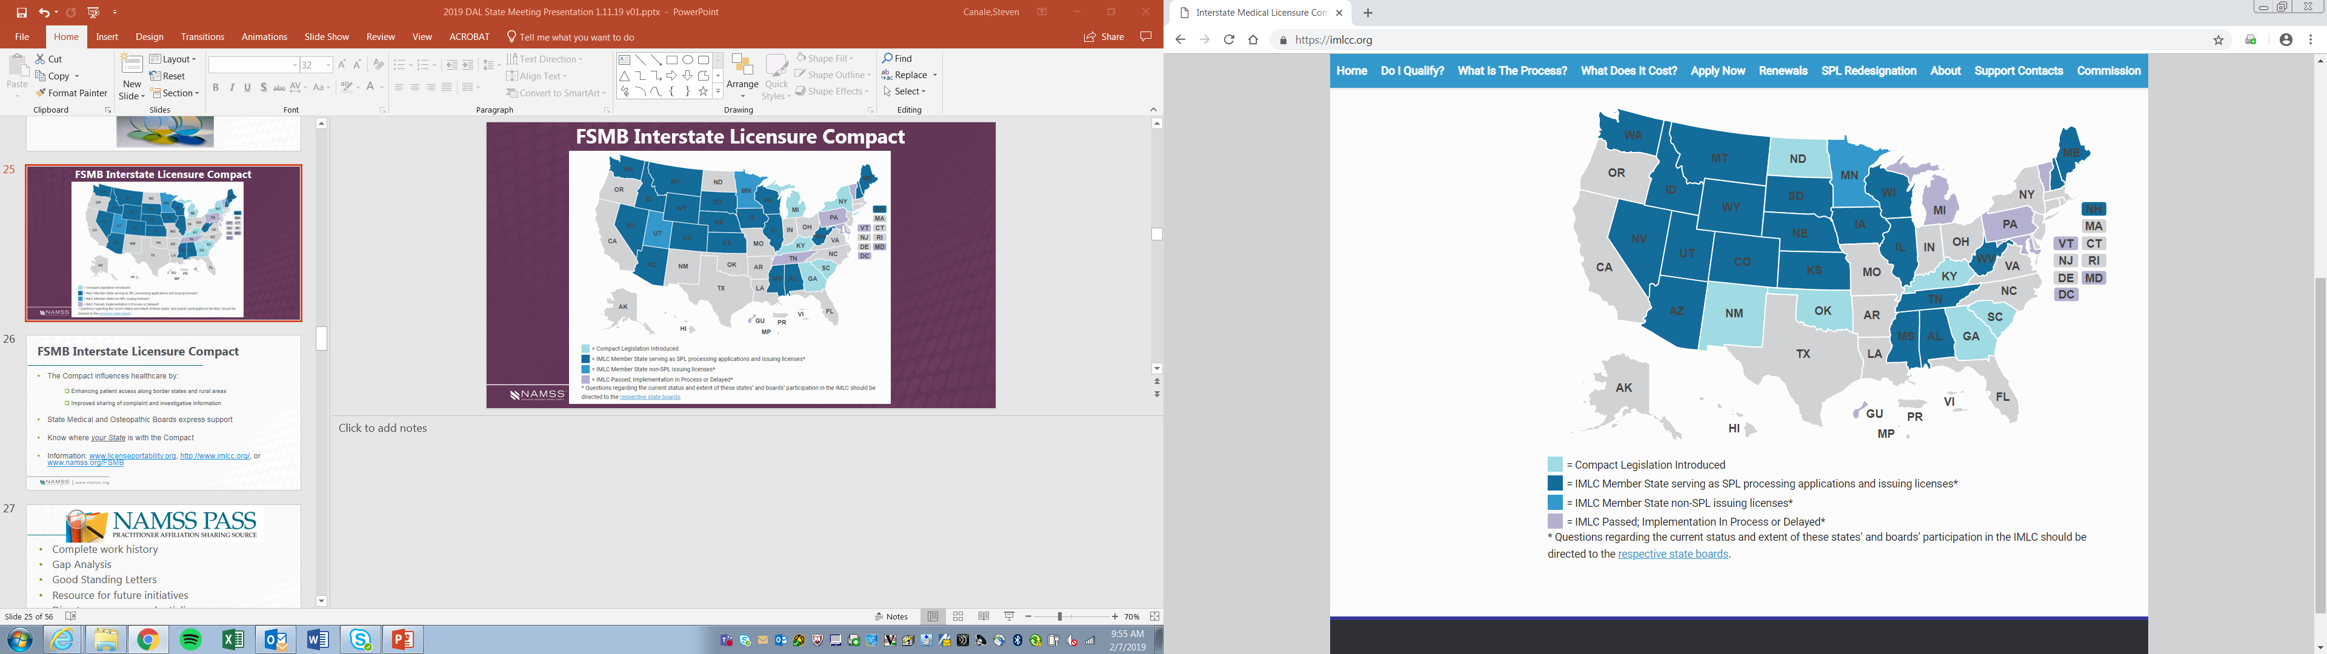
FSMB Interstate Licensure Compact

Slide 25

Complete work history
Gap Analysis
Good Standing Letters
Resource for future initiatives
Disaster response credentialing
Notes:
Secure, online database for verification of work history and gap analysis
Goal – to become the “go to” source for a complete affiliation work history
No more querying multiple hospital websites or faxing verification requests
Easily identify gaps in work history and unreported affiliations
Obtain verifications from closed facilities
Quick resource for credentialing practitioners volunteering during a disaster

Slide 26
Over 500 participating entities
Over 810,000 affiliations
Notes:
Provides two legally-vetted “Letters of Good Standing” templates
Providers verification of affiliation dates for closed facilities

Slide 27
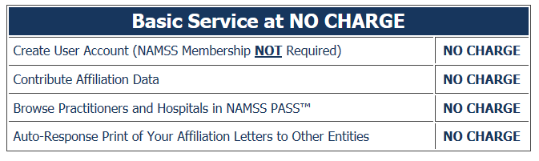
NAMSS PASS Fees
Notes:
There is NO cost to create a user account, and NO cost to browse for practitioners
There is NO cost to contribute your data (you are not required to use NAMSS PASS for providing affiliation verification letters/good standing letters)
There is NO cost to use NAMSS PASS to provide the auto-response affiliation letters to other entities

Slide 28
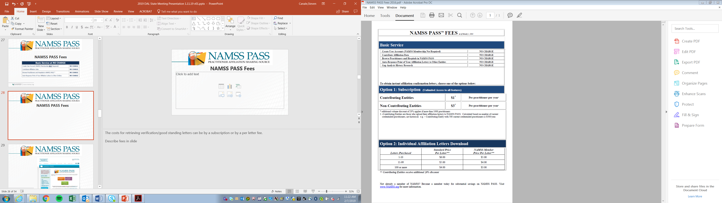
NAMSS PASS Fees
Notes:
The costs for retrieving verification/good standing letters can be by a subscription or by a per letter fee.
Describe fees in slide

Slide 29
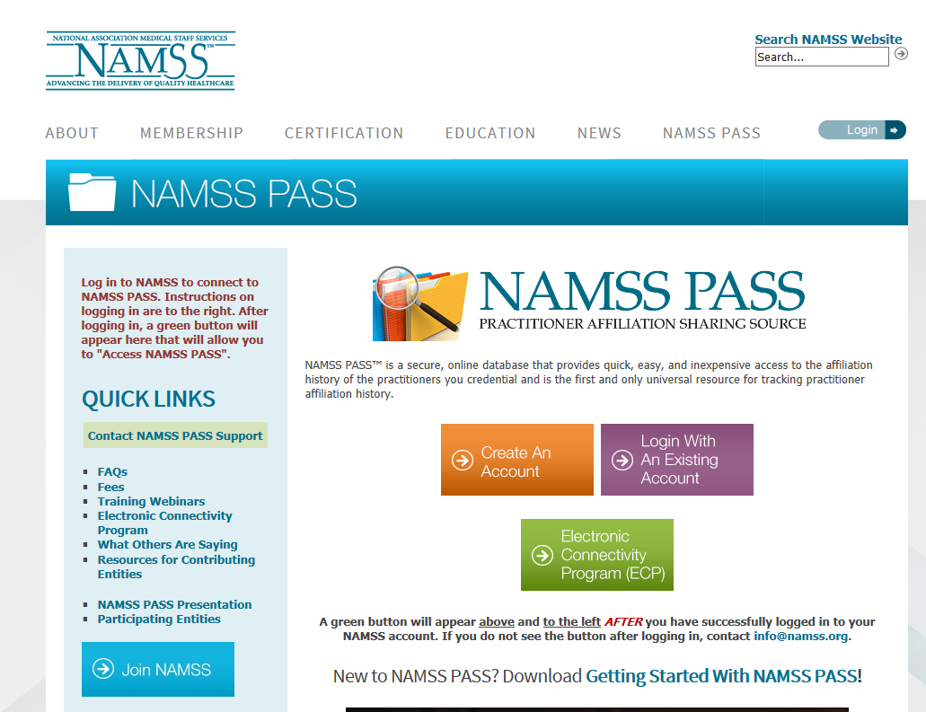
Notes:
Everything you need to know to get started or just to browse and explore the NAMSS PASS can be found at NAMSS website
Click on the FAQs for further information, including the format for providing your practitioner data, the definition of “good standing” and the form letters available to users

Slide 30
What else could PASS do to advance patient safety and efficient processes?
    International member support
    International influence with IAMRA
    Disaster response credentialing resource
    Affiliation verification from closed facilities
    Access to complete affiliation history, rather than relying on what could be an incomplete application

Slide 31
Certification
2021 Dates and Deadlines
Summer Testing Period
Application Deadline – Friday, January 22, 2021
Testing Period – Saturday, March 27 through Saturday, April 17, 2021
Summer Testing Period
Application Deadline – Friday, April 30, 2021
Testing Period – Saturday, June 26 through Saturday, July 17, 2021
Fall Testing Period
Application Deadline – Friday, August 27, 2021
Testing Period –Saturday, October 23 through Saturday, November 13, 2021
Notes:
All of the NAMSS 2021 CPCS and CPMSM Certification application deadlines.
All candidates are highly encouraged to fully review the Candidate Handbook available under the certification page of the website.
Due to restrictions in place in response to COVID-19, NAMSS began offering remote proctoring in 2020 to accommodate those whose local testing centers may be closed.
For more information on remote proctoring, please contact the NAMSS Certification Department (certification@namss.org).

Slide 32
Certification
Multiple Choice Exam – 3 options
  Start of Virtual Proctoring in Summer 2020
Practice Exam
Official results follow within six weeks of the closing of the testing window
Certification is for 3 years
Recertification required every 3 years
Notes:
Answers are multiple choice with 3 options
Virtual proctoring application was made available starting in the Summer 2020 testing window to accommodate at-home testing due to COVID-19
Exams are traditionally taken at testing centers
Exams are administered via computer, with 3 hours to complete the CPCS and 4 to complete CPMSM
A practice exam is available (see certification tab of the website) written to the same standards as the actual exams
Certification is issued for three years
Recertification every three years (for dual certificants, the cycle will follow the recertification due date of the initial certification earned)
For example:
CPCS earned in 2018
CPMSM earned in 2019
Recertification would be in 2021 for both, and every 3 years after that
I’ll talk about the importance of dual certification when we get to the section on volunteering

Slide 33
Certification
Certified Provider Credentialing Specialist (CPCS)
  Currently employed in the medical services profession for at least the past 12 months AND three years experience in the medical services profession within the past 5 years
  150 Questions, 3 hours
  Recertification every 3 years
  30 CEUs (of which 15 NAMSS approved)

Slide 34
Certification
Certified Provider Medical Services Manager (CPMSM)
  Currently employed in the medical services profession for at least the past 12 months AND five years of experience in the past eight years*
  175 Questions, 4 hours
  Recertification every 3 years
  30 CEUs (of which 15 NAMSS approved)

Slide 35
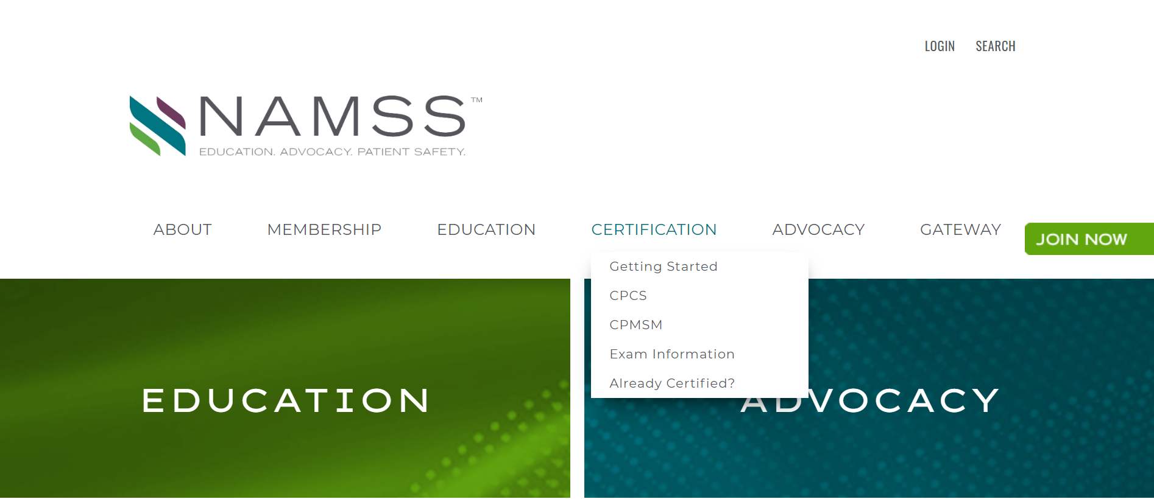
Certification
Online Certification Applications
CPCS Application: https://www.namss.org/Certification/CPCS
CPMSM Application: https://www.namss.org/Certification/CPMSM
Notes:
Both Exam applications can be found under the Certification tab. Simply hover over the Certification tab and you’ll see them in the drop-down menu.

Slide 36
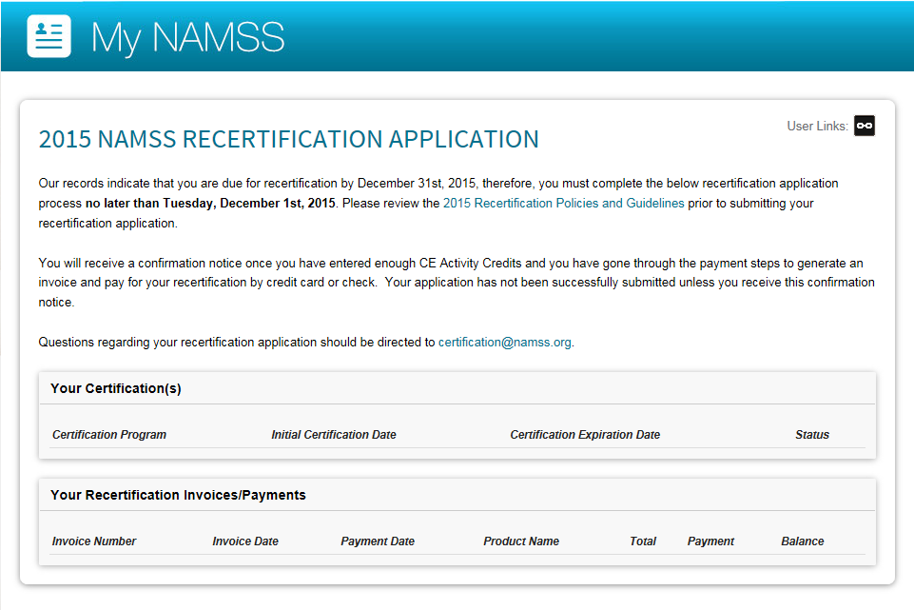
Certification
www.namss.org/recertification
Online Re-Certification Applications
Notes:
If you are due to recertify, NAMSS has an online recertification application which will allow you to enter your earned CE credits and submit payment with ease
The system allows you to pay by check as well
Even if you pay by check, all recertification applications must be submitted online moving forward
NAMSS will send a courtesy reminder when certification is due, but it is the burden of the certificant to submit required recertification application by the published deadline
You can go to NAMSS.org/recertification and find the link to the list of those requiring recertification this year

Slide 37
NAMSS Fellow Designation
Created in 2016
Recognizes career MSPs who have made outstanding contributions to the profession
Total Fellows as of 2020: 39
Applications will be open from May 31 through July 9, 2021
https://www.namss.org/Membership/NAMSS-Fellows
Notes:
Acknowledgment and recognition for the MSP who has made outstanding contributions to the profession through service as a leader, mentor, and educator.
Eligibility and application criteria can be found on the NAMSS website.

Slide 38
NAMSS Healthcare Hall of Fame
Created in 2016
Honors MSPs who have demonstrated enthusiasm, passion, dedication and commitment to the profession
Nominations taken annually every February/March
A maximum of 3 honorees will be inducted into the Hall of Fame annually
https://www.namss.org/Membership/NAMSS-Hall-of-Fame
Notes:
Eligibility and nomination criteria can be found on the NAMSS website. The nomination period for 2021 closed on March 5.

Slide 39
Benefits of NAMSS Membership:
Educational Resources
Discounted Webinars & Conferences
Discounted Publications
Synergy & Gateway
New in 2020: All Live Webinars Included with Active Membership
Mentoring Program
Notes:
NAMSS provides a multitude of educational opportunities across the country throughout the year
Our industry publication, Synergy, is released six times a year, and Gateway is released every month
New in 2020, live NAMSS webinars will be complimentary for NAMSS Active members - offering members more ways to gain free CE credits, hear from industry experts and gain valuable insights that can help them as MSPs. This is a savings of $55 per webinar!
In 2020, NAMSS members received free access to 21 live webinars, which provided them the opportunity to earn 18 free CEs!
The mentoring program offers new MSPs the opportunity to connect with an experienced MSP who is willing to share their experience and knowledge, and even help prepare for the certification exam

Slide 40
Benefits of NAMSS Membership:
Scholarships & Awards
NAMSS members are eligible to apply for the following scholarships and awards:
Scholarships
Charlotte Cochrane Scholarship
NAMSS Annual Conference or State/Local Annual Conference Scholarship
Leadership Development Scholarship
Other Continuing Education Scholarship
Awards
Leadership Award
Golden Key Award
Joan Covell-Carpenter Award
ICON Award
https://www.namss.org/Membership/Scholarships-Awards
Notes:
NAMSS offers a number of scholarship and awards designed to advance studies or to assist with attendance to NAMSS or State educational offerings.
NAMSS scholarships provide scholarship opportunities for NAMSS members to attend the National Conference & Exhibition and State/Local Conference, the NAMSS Education Summit, and/or to participate in other continuing education. Applications for scholarships are accepted twice a year.
NAMSS awards are presented to individuals that have shown dedication to the medical staff and credentialing services profession through their certification, leadership, and advocacy. Nominations for these awards are submitted in mid-June and the awards are presented at the annual conference.

Slide 41
Benefits of NAMSS Membership:
Networking Opportunities
Directory of NAMSS Members
Member Surveys & Resources
Access to the Job Board w/Positions Across the US
Discussion Forums
Marketing Materials
Notes:
NAMSS is committed to providing the resources necessary to keep our members connected and informed. Periodically NAMSS will perform surveys that benefit the profession and will post the results of those surveys to the NAMSS website for MSPs to reference when negotiating for changes to our departments. These surveys are available on the member resource site. The NAMSS Career Center gives members looking for a position or trying to fill a position the opportunity to post the position in a location that is viewed more than 12,000 times per month. NAMSS Discussion Forums is a member only resource developed to encourage networking and idea sharing among NAMSS members. If you have not visited the Discussion Forums recently I would encourage you to go on and post your most challenging opportunity. Your peers are usually very willing to share their best practice and tell you about their successes during survey to help you.
Marketing Materials - NAMSS Membership provides you access to materials that promote National Medical Staff Services Awareness Week and educate others about the value and importance of MSPs through the NAMSS store.

Slide 42
Volunteering with NAMSS
Board Nomination/ Application process
Committees
  Audit and Finance
  Certification Commission
  Conference Committee
  Education Committee
  Ethics Committee
  Membership Committee
  Leadership Selection Committee
  NAMSS Liaisons to the Board of Directors (Bylaws & Industry)
  Past Presidents
NAMSS Volunteer Registry
https://www.namss.org/About/Volunteer-Leaders
https://www.namss.org/About/Volunteer-Registry
Notes:
Call for Board Nominations Occurs in the Spring (late March/early April) of each year.
I mentioned the importance of dual certification for certain volunteering; all applicants for Board Nominations must now hold and maintain dual certification with NAMSS.
You can see the six committee and one commission listed here. The committees generally work via conference calls and email. The Certification Commission of NAMSS is an autonomous commission responsible for the development and maintenance of the two certification programs – CPCS and CPMSM.
The committee descriptions and responsibilities can be found on the NAMSS website under the “About” tab for each committee and the CCN
NAMSS Volunteer Registry; if you are interested in becoming involved without the full commitment of serving on a NAMSS Committee. Volunteers work on special projects, task force and strategic initiatives. Open year round.

Slide 43
Leadership Development Work Group
Chair: Debbie Kesselring, CPMSM, CPCS
Goals:
  Identify future NAMSS leaders
  Build a pipeline/database of potential volunteer leaders
  Mentor potential candidates for Board of Director and Committee roles
Notes:
If you have any interest in getting involved with NAMSS, whether at the Board or Committee level, I encourage you to reach out to Debbie Kesselring, chair of the NAMSS Leadership Development Workgroup. She or a member of the work group can help you with next steps and assist you with submitting an application for a committee or the Board. You can find the listing of members and their contact information on the NAMSS website.
NAMSS formed the work group to assist with the development of a leadership succession plan, identify future NAMSS leaders and help NAMSS develop a pipeline and database of potential volunteer leaders. This group will identify and mentor potential candidates for Board of Director and Committee roles.

Slide 44
Leadership Selection Committee
Focused on:
Training
Vetting Future Leaders
Approved NAMSS Principles of Leadership
Overseeing NAMSS Hall of Fame program
Overseeing Fellow Designation
Notes:
The Leadership Selection Committee is primarily responsible for identifying and training future elected NAMSS leaders. The Committee has other responsibilities which include:
Approving the NAMSS Principles of Leadership
Oversight of the NAMSS Hall of Fame
Oversight of the Fellow Designation

Slide 45
Diversity, Equity & Inclusion Task Force
Chair: Pearl N Williams, MSA, CPMSM
Goals:
  Ensure that NAMSS embodies all facets of diversity (inclusiveness, mutual respect, multiple perspectives, and equitable opportunities) so that all members, irrespective of race, ethnicity, nationality, cultural background, sexual orientation, gender identity, religion, age, income, physical and mental ability have equal opportunity to participate in NAMSS and thrive in the Medical Services Profession.
https://www.namss.org/About/Volunteer-Leaders/Diversity-Equity-Inclusion-Task-Force
Notes:
NAMSS is committed to enhancing the professional development of and recognition for all professionals in the medical staff and credentialing services field. In 2017, the NAMSS Board of Directors developed and adopted a Statement on Diversity and Inclusion, which reflects the association’s commitment to building an organization that appropriately reflects the diversity of the medical services profession. In 2020, NAMSS reinforced their commitment to supporting all members and assembled a Diversity, Equity and Inclusion Task Force to identify DEI education, resources and action items NAMSS can take to foster an inclusive community.

Slide 46
Leadership Certificate Program
Launched in 2016
Combination of online modules and live workshop
Ideal Participants:
  CPCS and/or CPMSM certification
  Minimum five years of experience in the industry
  Title of “Manager” or above
FREE Introduction course – 1.0 CE
*Online modules must be completed prior to live workshop participation
Will be offered virtually in 2021!
Notes:
If you are ready to take on a leadership role within your work place, the NAMSS Leadership Certificate Program will get you there. Through a series of both live and online courses, this new program allows MSPs dedicated to the field to expand on their experiences and gain the skills, confidence, and industry understanding to be stronger leaders within the industry.
The NAMSS Leadership Certificate Program is an ideal option for MSPs with the CPCS or CPMSM credential and a minimum of five years’ industry experience with the title of Manager and above. However, the program is open to NAMSS members and non-members and all medical services professionals who are interested in advancing their role and responsibilities as leaders.
Online modules will be available through the NAMSS Education page. Users now have the ability to purchase the entire online program at once, or each course individually. We anticipate the online portion of the program taking between 15-20 hours to complete.
NAMSS will be offering the Leadership Certificate Program virtually for the first time in 2021. Registration will open in early 2021.

Slide 47

Upcoming NAMSS Events
March 2021
Four courses will be offered virtually:
  CPCS Virtual Certification Preparation Course
  CPMSM Virtual Certification Preparation Course
  Credentialing 101
  Leadership Certificate Program (April 2021)
  https://www.namss.org/Education/NAMSS-Education-Month
Notes:
In 2021, NAMSS will be hosting it’s first ever virtual Education Month in March. NAMSS will be offering four courses:
CPCS Virtual Certification Preparation Course
CPMSM Virtual Certification Preparation Course
Credentialing 101
Leadership Certificate Program
The two prep courses and Credentialing 101 were offered for the first time virtually in the fall of 2020. They were a huge success, with CPCS Prep Course and Cred 101 both selling out! Leadership Certificate Program will be offered for the first time in 2021 as part of Education Month.

Slide 48
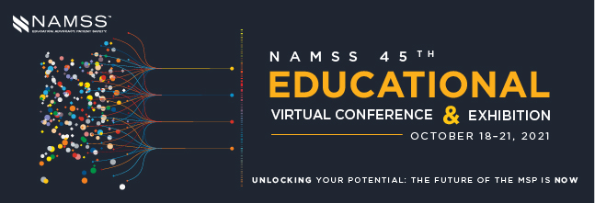
Upcoming NAMSS Events
Notes:
Join NAMSS for the 45th Virtual Educational Conference & Exhibition, October 18-21, 2021! Be on the look out for more information as we get closer to registration opening this summer!

Slide 49
More Networking Opportunities
Like Us on Facebook!
www.facebook.com/namssnational
Subscribe to the NAMSS Discussion Forum!
Visit the Forum directly here, or at https://www.namss.org/Membership/Member-Resources
Visit the NAMSS website for the Gateway Hub:
https://www.namssgateway.org/
Follow us on Twitter
https://twitter.com/NAMSS_News
Join our LinkedIn Group
https://www.linkedin.com/company/namss---national-association-medical-staff-services
Notes:
Networking – Connect with over 5,500+ members who can help answer your questions that you face on the job. Visit the NAMSS Discussion Forum and post your questions online or look up contact information on the online directory.

Slide 50
NAMSS Will Continue to…
Serve as the voice of the profession, advocating on behalf of MSPs across the nation
Provide educational and professional development opportunities that meet the ever changing health care environment we navigate through today
Support state affiliates and associations on the local level
Inform and connect the network of medical services professionals and credentialing services professionals
But we will be doing this in ways that create the most value and help members be the most successful in their ever changing and challenging health care roles!
Notes:
While NAMSS supports both members and non-members, you can see there are many benefits to being a NAMSS member. The ongoing information on government updates, advocacy, synergy and discounted annual conference fee is worth the cost of the annual membership. I encourage all of you who are not currently members to evaluate all of the benefits of membership and to consider joining NAMSS in the future.

Slide 51
Questions?
NAMSS Executive Office
2001 K Street NW, 3rd Floor North
Washington, DC 20006
(202) 367-1196 | info@namss.org
Director at Large:
Alison Webster
Alwebster@salud.unm.edu
505 272-9441
Notes:
Add DAL contact information

