Slide 1
7 HABITS OF HIGHLY EFFECTIVE MSP’S
North Carolina Association Medical Staff Services
May 14, 2021
Renee Aird Dengler, RN, MS, CPMSM, CPCS, FMSP

Slide 2
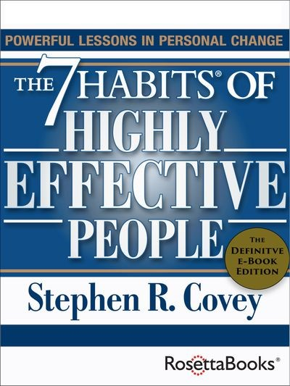
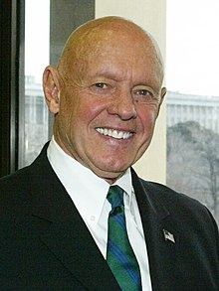
*New York Times bestseller—over 40 million copies sold*
*The #1 Most Influential Business Book of the Twentieth Century*
First Published - 1989
One of the most inspiring and impactful books ever written, The 7 Habits of Highly Effective People has captivated readers for nearly three decades. Stephen R. Covey’s timeless wisdom has inspired people of all ages and walks of life to not only improve their businesses and careers but to live with integrity, service, dignity, and success in all areas of life.

Slide 3
AGENDA
What are the 7 Habits
How do we apply them to our life
How can we apply them to our work life/career

Slide 4
COMMON ISSUES
Credentialing Takes Too Long
  Low Satisfaction, Lost Revenue
Streamline the Initial Application Process
  Hand-Offs, Applications Not Complete
Make the Reappointment Process Less Stressful
  Don’t get them back on time, Chaotic process
A lot of Burdensome, Non-Value-Added Tasks or Misapplied Work
  Does this work belong in (MSO, CVO, PE, etc.)? Where? Who?
Meetings
  Too many, too long, time wasters…

Slide 5
A HABIT
Habit – a behavior that starts as a choice and then becomes a nearly unconscious pattern. The behavior has become a habit.
Habits – healthy, unhealthy or neutral
Break a Habit – research suggests 18-254 days
Create a Habit – 66 days – over two months of daily repetitions

Slide 6
What are “The Habits”
Habit 1: Be Proactive
  Personal Responsibility
Habit 2: Begin with the End in Mind
  Personal Vision
Habit 3: Put First Things First
  Personal Management
Habit 4: Think Win/Win
  Mutual Benefit
Habit 5: Seek First to Understand, Then to Be Understood
  Empathic Communication
Habit 6: Synergize
  Creative Cooperation
Habit 7: Sharpen the Saw
  Daily Self-Renewal

Slide 7
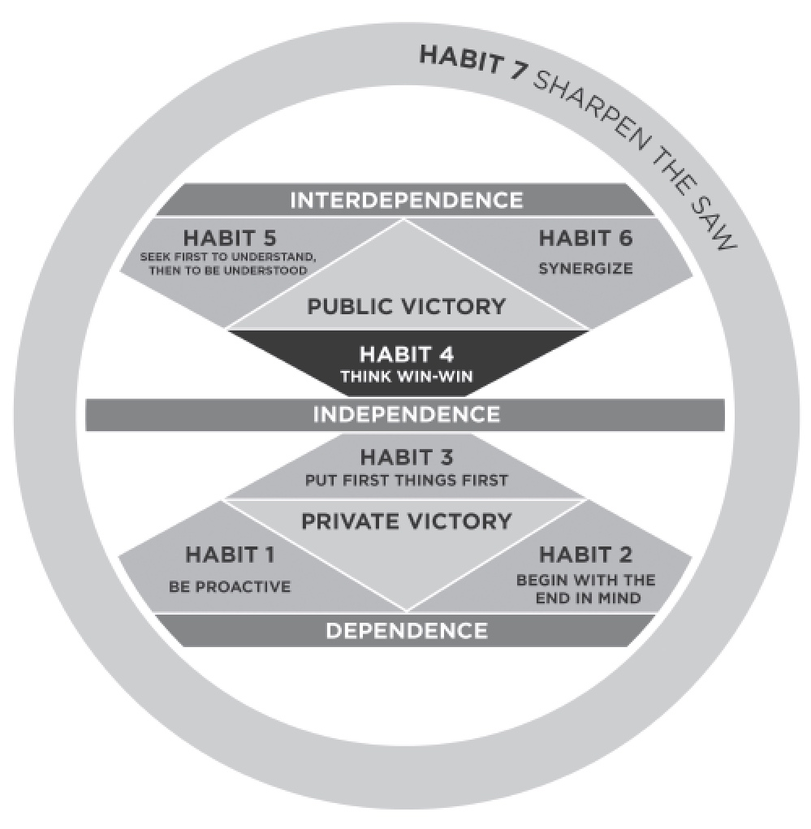

Slide 8
DEPENDENT, INDEPENDENT, INTERDEPENDENT
Dependent – Need others to get what they want.
Independent – Get what they want through their own effort.
Interdependent – Combine their own efforts with the efforts of others to achieve their greatest success.

Slide 9
DEPENDENT – INDEPENDENT - INTERDEPENDENT
DEPENDENT
1. BE PROACTIVE
2. BEGIN WITH THE END IN MIND
3. PUT FIRST THINGS FIRST
INDEPENDENT
4. THINK WIN-WIN
5. SEEK FIRST TO UNDERSTAND, THEN TO BE UNDERSTOOD
6. SYNERGIZE
INTERDEPENDENT
7. SHARPEN THE SAW

Slide 10
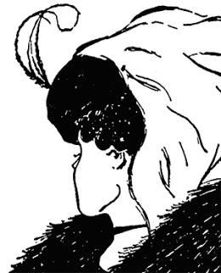

Slide 11
#1 - BE PROACTIVE
Habit of Personal Responsibility
Proactive v Reactive
Reactive
  React based on mood, feelings – blame, accuse, victim language – waste time and energy on things you can’t control
Proactive
  Pause, allow yourself to choose a response based on your principles and desired results
Reactive Language v Proactive Language
  I can’t – I can
  There’s nothing we can do – There must be something we can do

Slide 12

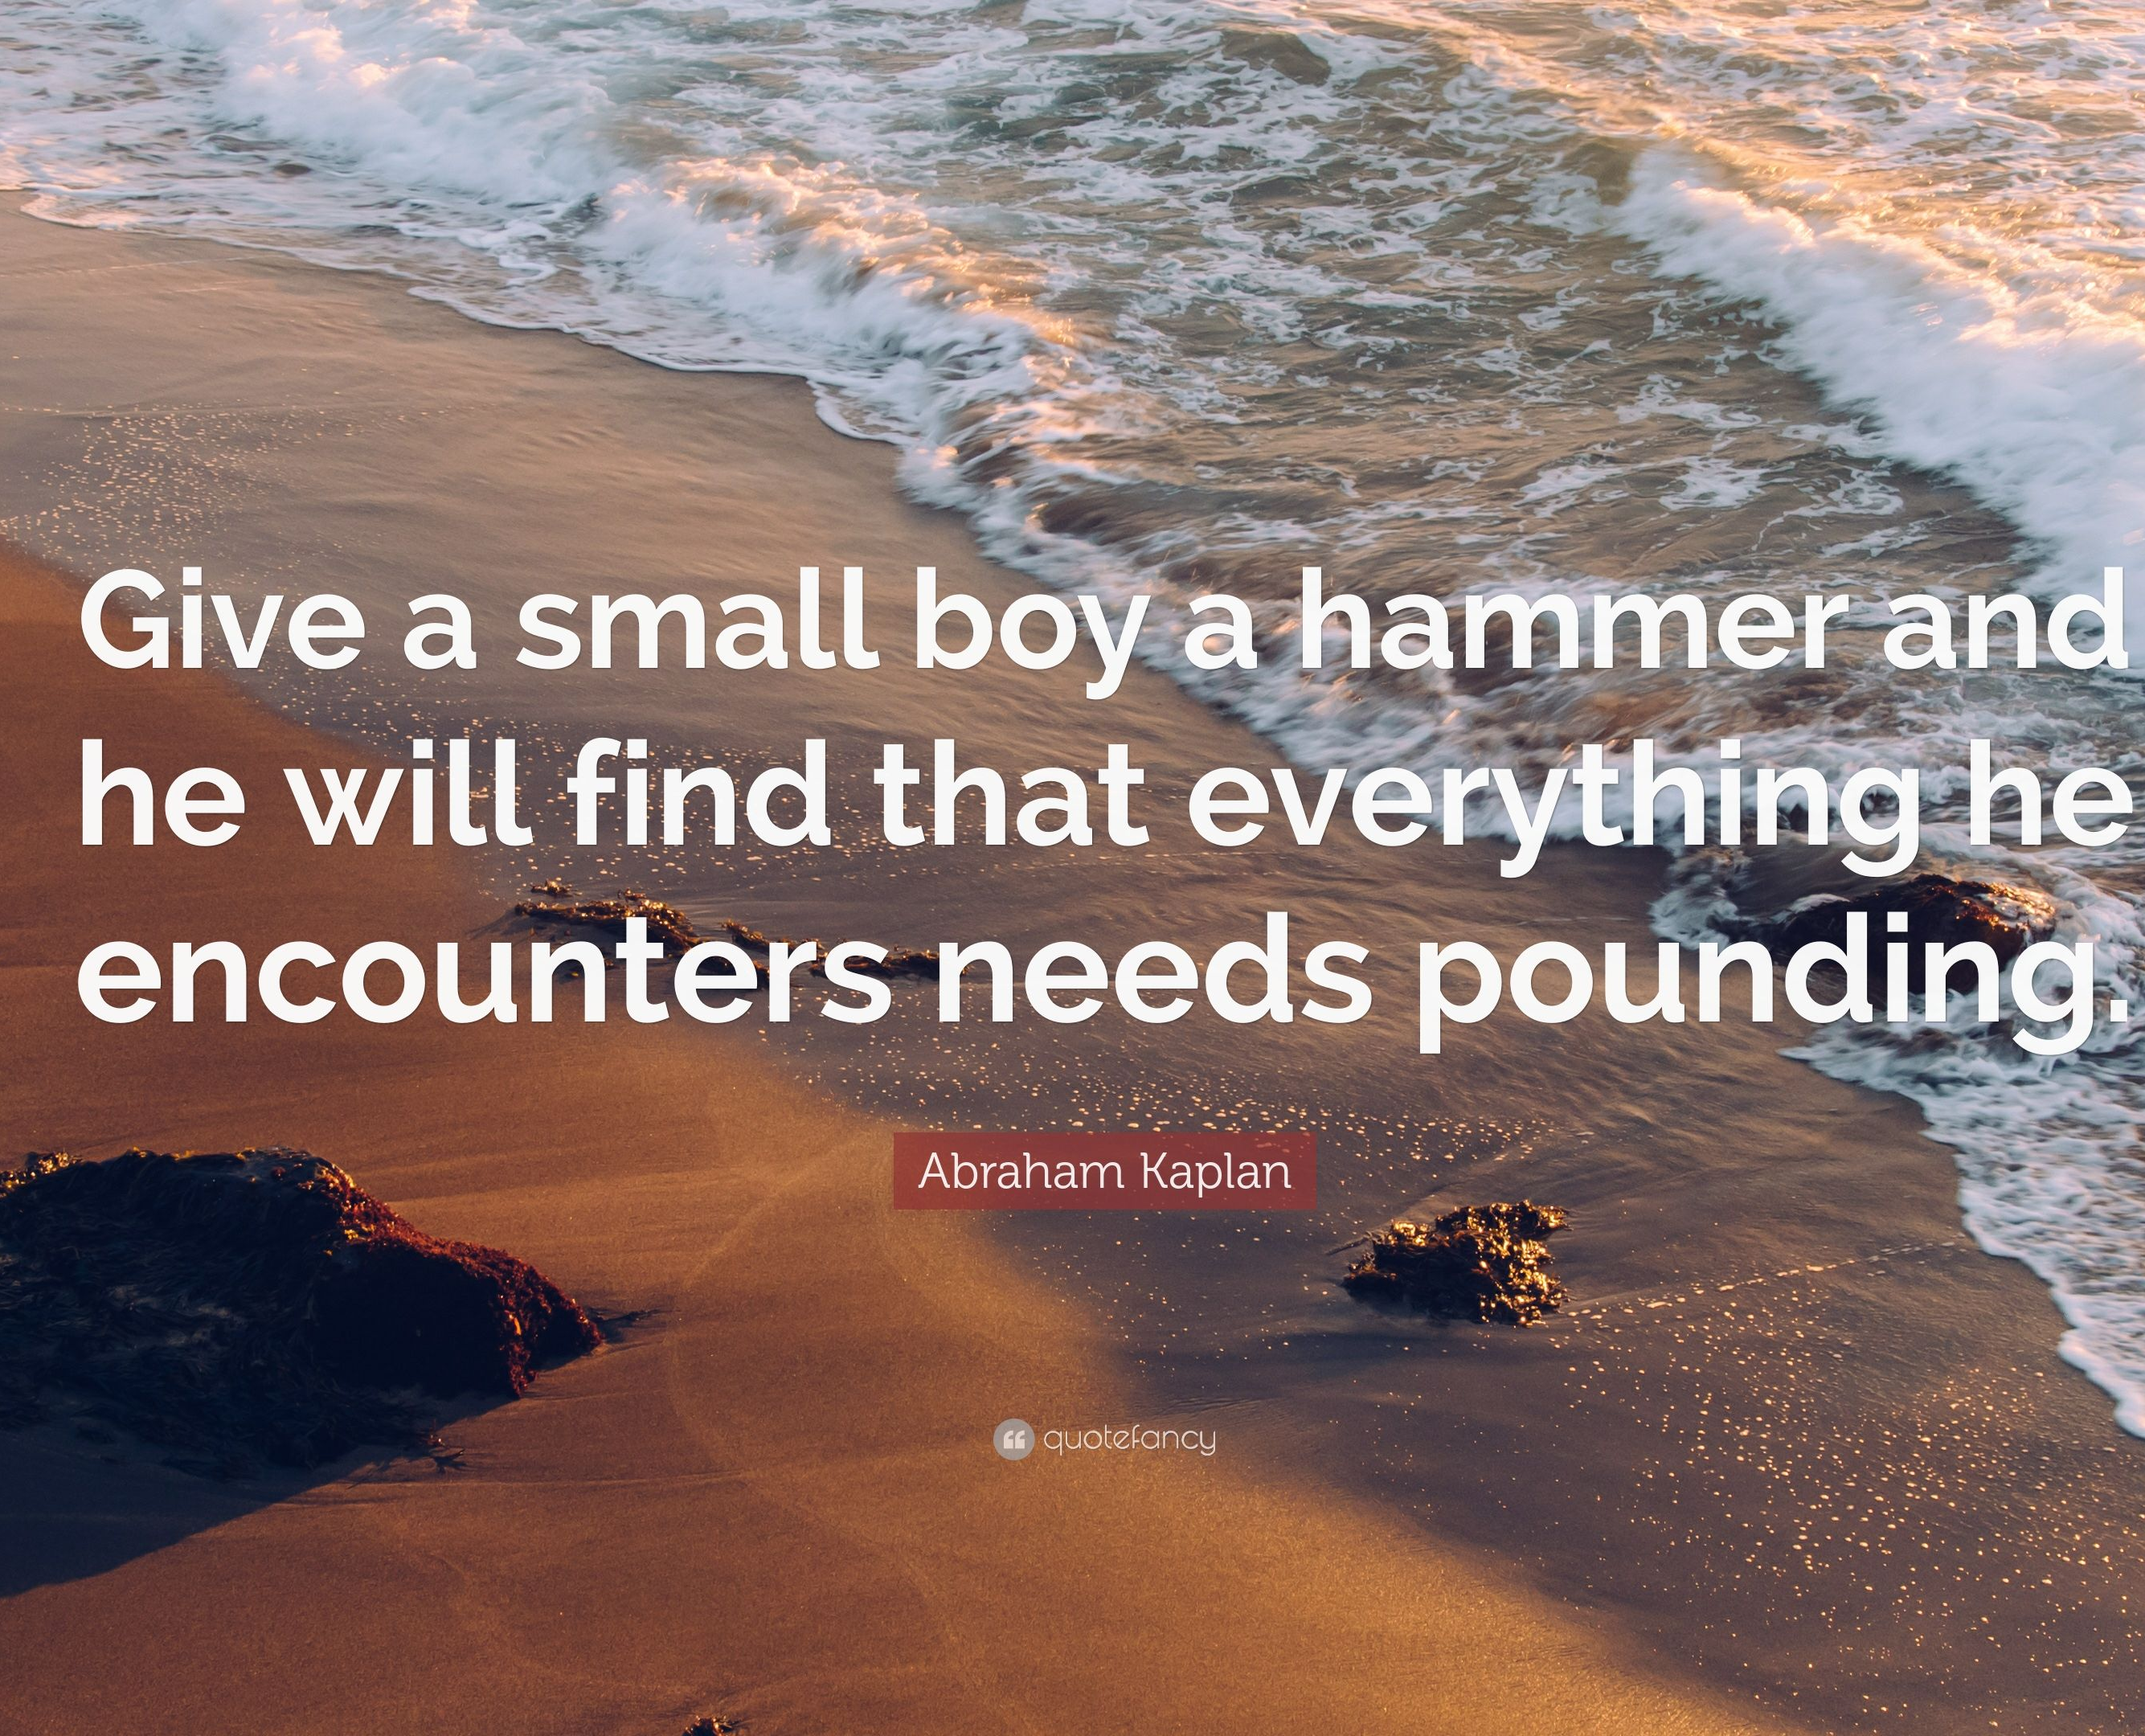

Slide 13
#1 - BE PROACTIVE
Change your Paradigm
A paradigm is a standard, perspective, or set of ideas.
A paradigm is a way of looking at something. When you change paradigms, you're changing how you think about something.

Slide 14
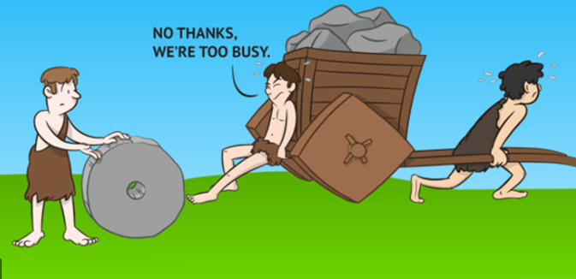

Slide 15
BE PROACTIVE
Circle of Concern v Circle of Influence
Don’t focus on what you can’t control.
Focus on those things where you have some influence.
  What can you do rather than what can’t you do.
You can’t ruin my day!
You have choices. You choose how you react.

Slide 16

“One day Alice came to a fork in the road and saw a Cheshire cat in a tree.
Which road do I take? she asked.
Where do you want to go? was his response.
I don't know, Alice answered.
Then, said the cat, it doesn't matter.”

Slide 17
#2 - BEGIN WITH THE END IN MIND
Habit of Personal Vision
Leadership Habit
What is your Vision?
To Begin with the End in Mind means to start something after thinking about the expected result
If you don’t know what you expect – anything you get is ok…

Slide 18
#2 - BEGIN WITH THE END IN MIND
Habit of Personal Vision
Start with a Vision – If you don’t know where you’re going, how will you know when you get there?
Define outcomes before you start/act
  What will it look like?
  How will I know?
  How do I get from here to there?
Start with the Outcome and work backwards
If you’re really working hard to be a success, make sure your ladder is leaning against the right wall.

Slide 19
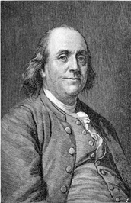
“For the want of a nail the shoe was lost,
For the want of a shoe the horse was lost,
For the want of a horse the rider was lost,
For the want of a rider the battle was lost,
For the want of a battle the kingdom was lost,
And all for the want of a horseshoe-nail.”
Poor Richards Almanack, June 1758

Slide 20
#3 - PUT FIRST THINGS FIRST
Habit of Personal Management
Management Habit
“The main thing is to keep the main thing the main thing.”
Common Practices
  Spend your time on managing crises and other people’s agendas
  Try to do it all
  Plan sporadically, or not at all
  Give in to the pressures of the moment

Slide 21
#3 - PUT FIRST THINGS FIRST
Habit of Personal Management
Effective Practices
  Focus on your highest priorities
  Eliminate the unimportant
  Plan every week
  "The key is not to prioritize what's on your schedule, but to schedule your priorities."

Slide 22
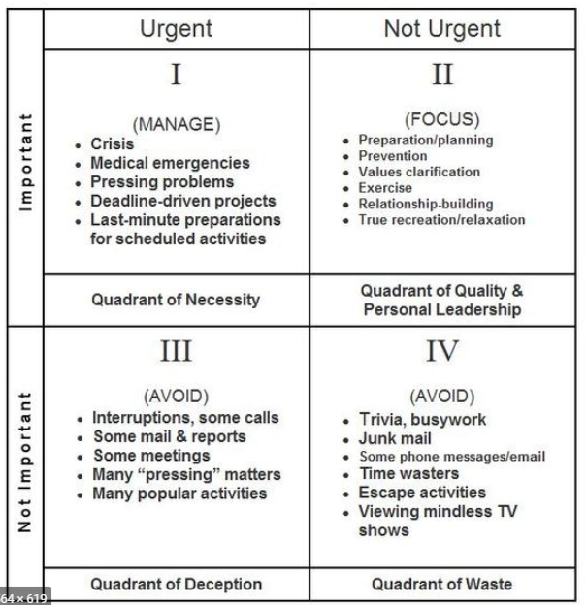

Slide 23
 | Urgent | Not Urgent
Important
Not Important
I
II
Quality &
Personal Leadership
Necessity
III
IV
Deception
Waste

Slide 25
Private Victories to Public Victories
Private Victories (Be Proactive, Begin with the End in Mind, First Things First
  Taking full responsibility for yourself
  Deciding what you want
  Live by it and do it
Public Victories (Think Win-Win, Seek first to Understand, then to be Understood, Synergize)
  Success with others
  Shared victories
  Built on the private victories of the first three habits

Slide 26
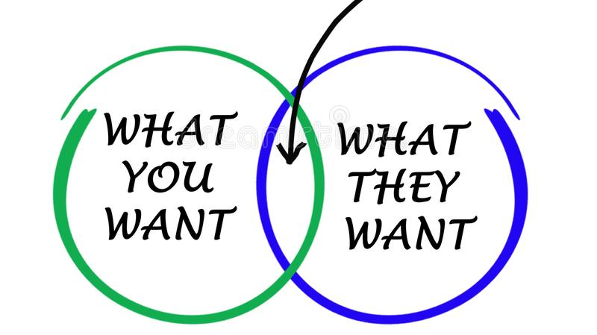

Slide 27
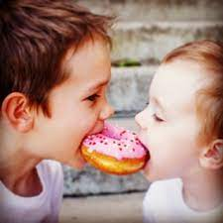
We both win. Both are pleased and harbor no ill will
I Lose
They win
I am angry and will seek justice later
I win
They lose
They are angry and will seek justice later
We Both Lose

Slide 28
#4 - THINK WIN-WIN
Habit of Mutual Benefit
Change The Paradigm
The more you get, the less there is for me
There is plenty for everyone

Slide 29
#4 - THINK WIN-WIN
Habit of Mutual Benefit
Courage
Rarely voice ideas out loud
Concede quickly when others disagree
Share ideas and opinions with confidence
Not threatened by honest feedback

Slide 30
#4 - THINK WIN-WIN
Habit of Mutual Benefit
Consideration
Interrupt, finish sentences or talk over
Check email, text or take phone calls
Everyone has an opportunity to speak
Acknowledge other’s ideas and opinions

Slide 31

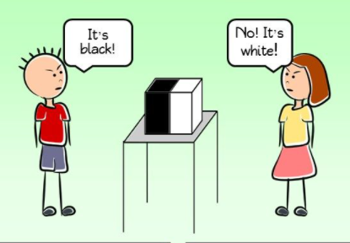

Slide 32


Slide 33
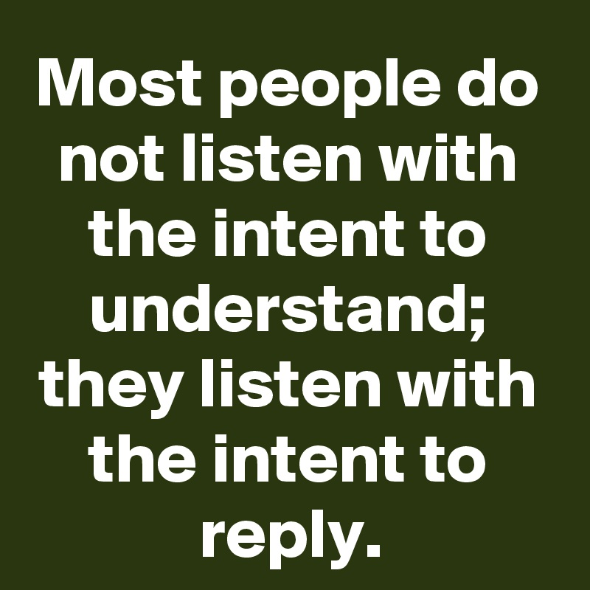

Slide 34
#5 - SEEK FIRST TO UNDERSTAND, THEN TO BE UNDERSTOOD
Habit of Empathic Communication
Am I really listening or am I formulating my response?
Listen with the intent to understand rather than the intent to respond

Slide 35
#5 - SEEK FIRST TO UNDERSTAND, THEN TO BE UNDERSTOOD
Habit of Empathic Communication
Empathic Listening
  Stop talking and listen
  Don’t be afraid of silence
Clarifying Questions
  When you say…
  Can you tell me more about…
Express your point of view
  Thanks for sharing your thoughts. Would you be willing…
  I can see what you mean. I have a different point of view I’

Slide 36
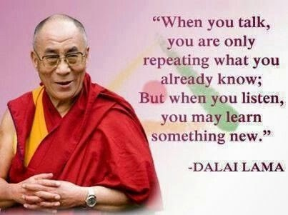

Slide 37


Slide 38
#6 – SYNERGIZE
The Habit of Creative Cooperation
Compromise vs Coming up with a solution that’s better than what either party had in mind
Is there another alternative?
Reject, tolerate or value differences
In Synergy / Not In Synergy

Slide 39
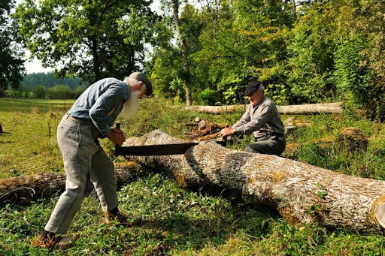

Slide 40
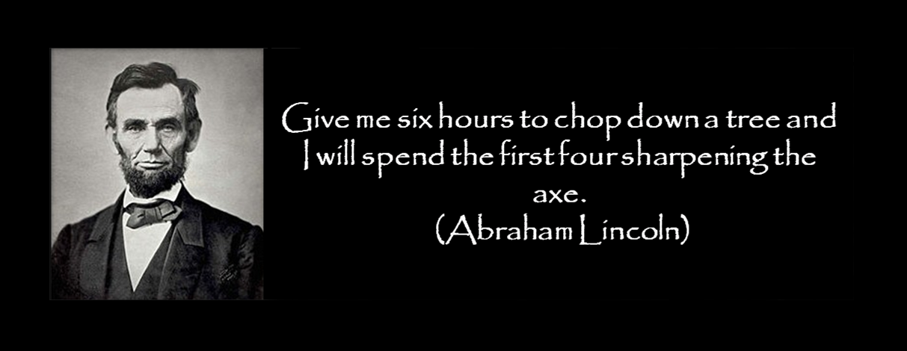

Slide 41
#7 – SHARPEN YOUR SAW
The Habit of Daily Self-Renewal
The principles of renewal, continuous improvement and balance.
I’m too busy to…
I don’t have time to…

Slide 42
#7 – SHARPEN YOUR SAW
The Habit of Daily Self-Renewal
Body (Physical)
  Exercising, healthy eating, resting
Mind (Mental)
  Learning, reading, writing, teaching
Heart (Social/Emotional)
  Social/meaningful connections, widen circle, listen to those important to you
Spirit (Spiritual Capacity)
  Spending time in nature, meditation, music, art, prayer, service to others

Slide 43


